Slide 1
Residential Acoustics
Building Acoustics | Sound Insulation Testing | Environmental Noise & Vibration
Dominic Parkinson
Associate Director
dominic.parkinson@amplitudeacoustics.com

Slide 2
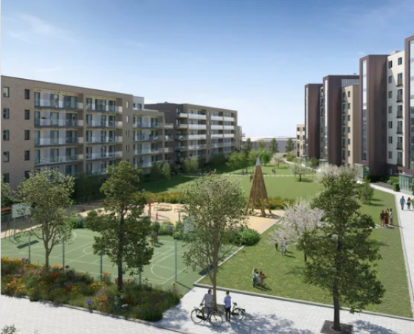
Objectives
Who we are
Residential Acoustic Criteria
Façade Assessment
TGD-E Sound Insulation
Airborne Sound Insulation
Impact Sound Insulation
Testing Requirements
Detailing
TGD-E Reverberation
Common Issues

Slide 3
Who We Are?
Emmet English Director
Dominic Parkinson Associate Director
Ronan Murphy Principal Acoustic Consultant
Barry McCann Acoustic Consultant
Tracey Matthews
Office Manager
Miguel Cartuyvels Graduate Acoustic Consultant
Stephen McDonagh Acoustic Consultant

Slide 4
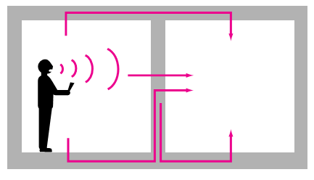
What We Assess - Residential
Noise Intrusion
Room Acoustics
Sound Insulation
HVAC Noise

Slide 5
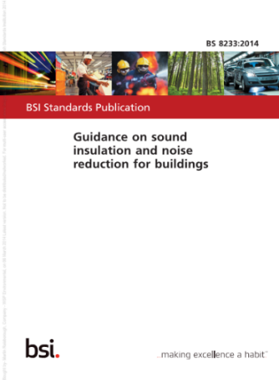
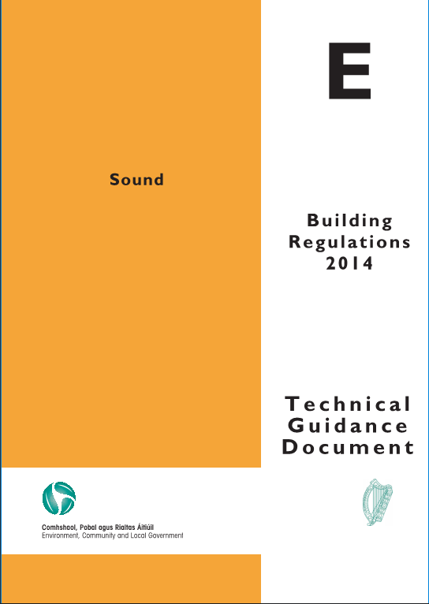
Acoustic Criteria – Relevant Documents
Sector | Regulation, Standards and Best Practice Guidance
Residential | BS 8233: Guidance on Sound Insulation and Noise reduction for buildings Technical Guidance Document E 2014 CIBSE

Slide 6
Noise Intrusion

Slide 7
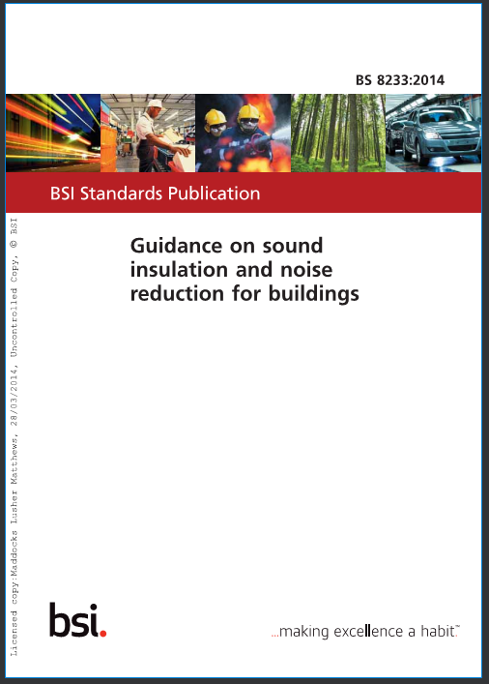
Acoustic Criteria – Indoor Ambient Noise Levels
Activity | Rooms | Design Range L_{Aeq,T} dB
 |  | 07:00 to 23:00 | 23:00 – 07:00
Resting | Living Rooms | 35 | -
Dining | Dining room/area | 40 | -
Sleeping (daytime resting) | Bedroom | 35 | 30
Typically Applied: *For a reasonable standard in bedrooms at night, individual noise events (measured with F time-weighting) should not normally exceed 45 dB L_{Amax.}

Slide 8
Acoustic Criteria – Indoor Ambient Noise Levels
Internal Noise Level Office
50-55dBA
Typical busy Road at pavement
65-70dBA
Construction Noise
85dBA+

Slide 9
Sound Insulation – Determining Façade Performance
Establish Noise Levels on Site
Measure or Predict the noise levels on site
Predictions of traffic, rail, plant and aircraft can be undertaken with the aid of 3D Modelling Software

Slide 10
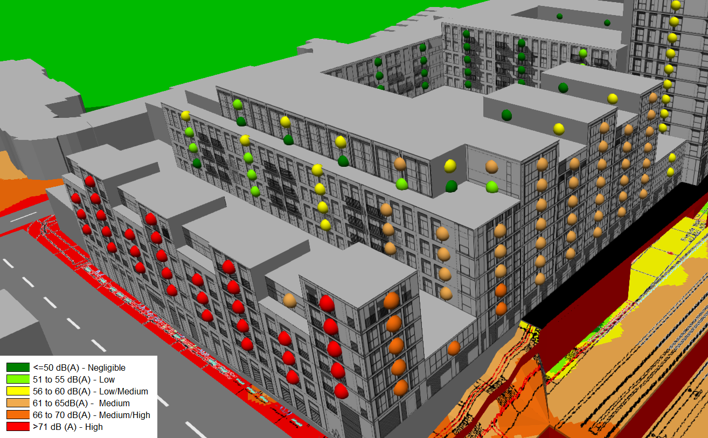
Sound Insulation – Determining Façade Performance
Establish Noise Levels Incident on the Building

Slide 11
Specification
For Specification, a Single R_{w} level is not sufficient.
Minimum Sound Reduction Values shall be given at Octave Band Centre Frequencies.
The lab should be accredited by a third party (UKAS or similar).
The system as whole shall meet the requirements Framing + Glass
Good manufacturers will have libraries of data.
Calculations (using Insul or similar software) are estimates with limited accuracy (±3 dB) and should be treated with extreme caution.
Minimum Sound Reduction Indices (dB) at Octave Band Centre Frequencies (Hz) |  |  |  |  |  |  |  | R_{w}
63 | 125 | 250 | 500 | 1k | 2k | 4k | 8k
15 | 20 | 19 | 29 | 38 | 34 | 45 | 45 | 31

Slide 12
Technical Guidance Document-E (TGD-E)

Slide 13
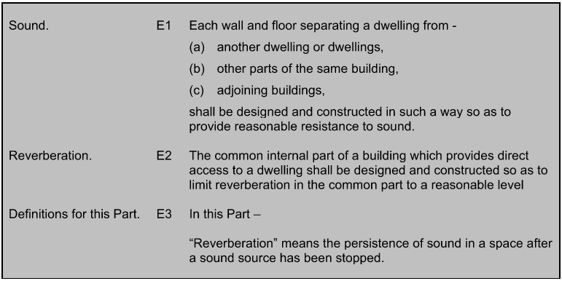
Technical Guidance Document E
To ensure that dwellings achieve reasonable levels of sound insulation from sound transmission emanating from adjoining buildings or differently occupied parts of the same building.

Slide 14
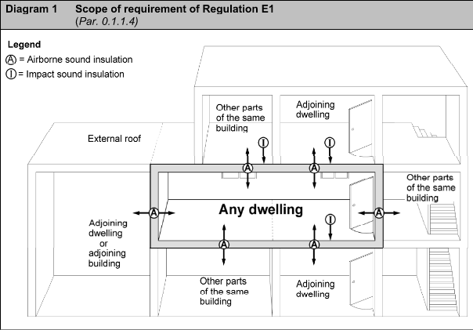
Requirements – E1 Technical Guidance Document E
Sound E1. Each wall and floor separating a dwelling from -
(a) another dwelling or dwellings,
(b) other parts of the same building,
(c) adjoining buildings,
shall be designed and constructed in such a way so as to provide reasonable resistance to sound.

Slide 15
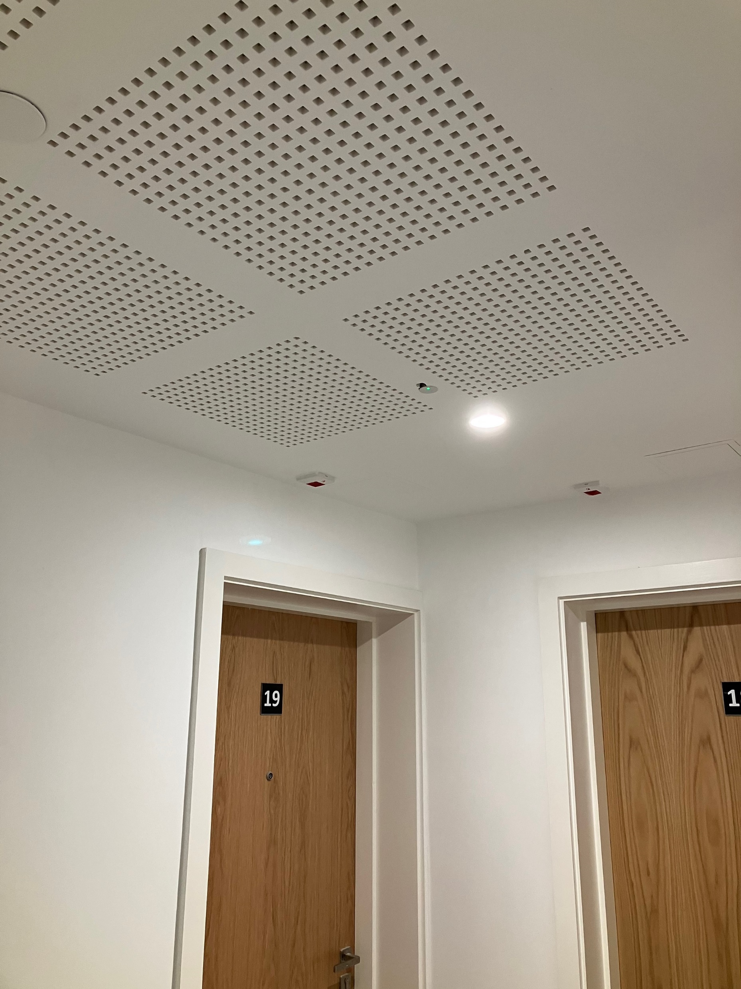
Requirements – E1 Technical Guidance Document E
Reverberation E2. The common internal part of a building which provides direct access to a dwelling shall be designed and constructed so as to limit reverberation in the common part to a reasonable level

Slide 16
TGD-E Sound Requirement E1

Slide 17
TGD-E – Sound Insulation
Separating Construction | Airborne Sound Insulation D_{nT,w} dB | Impact Sound Insulation L_{nT,w} dB
Walls | ≥53 (min) | -
Floors (Including Stairs with a separating function) | ≥53 (min) | ≤58
Note
A higher standard of sound insulation may be required between spaces used for normal domestic purposes and communal or non-domestic purposes. In these situations, the appropriate level of sound insulation will depend on the noise generated in the communal or non-domestic space.
Specialist advice may be needed to establish if a higher standard of sound insulation is required in order to achieve a reasonable resistance to sound
Doors
29 dB Rw Or Mass per unit area 25 kg/m² and well sealed

Slide 18
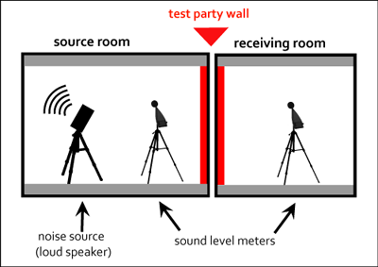
Airbourne Sound Insulation Walls and Floors – D_{nT,w}
Separating Construction | Airborne Sound Insulation D_{nT,w} dB
Walls | ≥53 (min)
Floors (Including Stairs with a separating function) | ≥53 (min)
Sound Insulation performance is defined by:
D_{n,Tw –} The Weighted Standardised Level Difference
Level Difference (D)
Corrected background noise (n)
Standardized for Reverberation Time (T)
Weighted to give a single value (w)

Slide 19
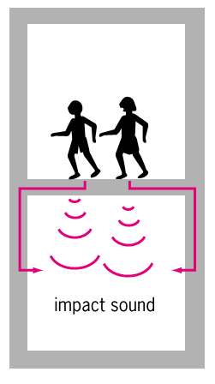
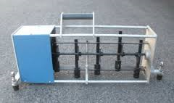
Impact Sound Insulation – Floors Only – L_{nT,w}
Separating Construction | Impact Sound Insulation L_{nT,w} dB
Floors (Including Stairs with a separating function) | ≤58
Sound Insulation performance is defined by:
L_{n,Tw –} The Weighted Standardised Impact Sound Pressure Level
Measured sound level (L)
Corrected background noise (n)
Standardized for Reverberation Time (T)
Weighted to give a single value (w)

Slide 20
Constructions – Internal Sound Insulation

Slide 21
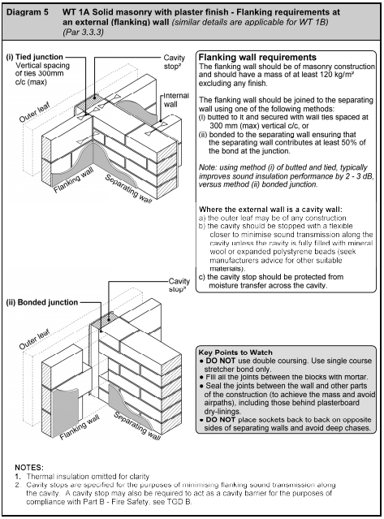
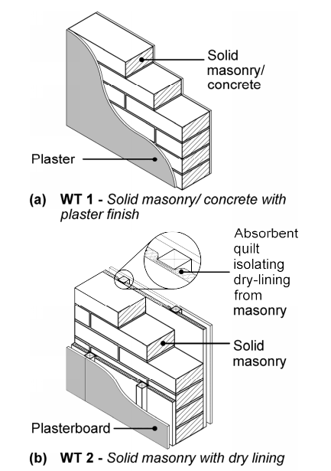
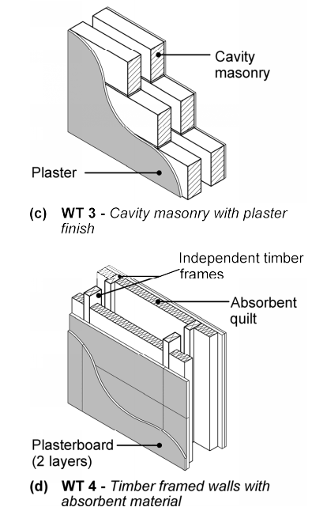
TGD-E - Assessed Certified Details (Walls)

Slide 22
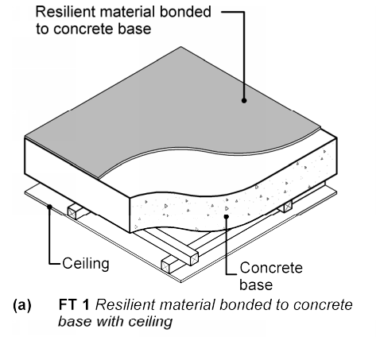
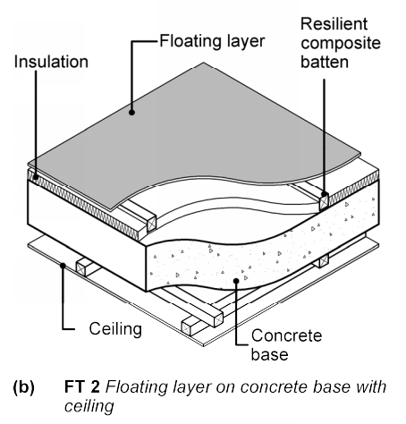
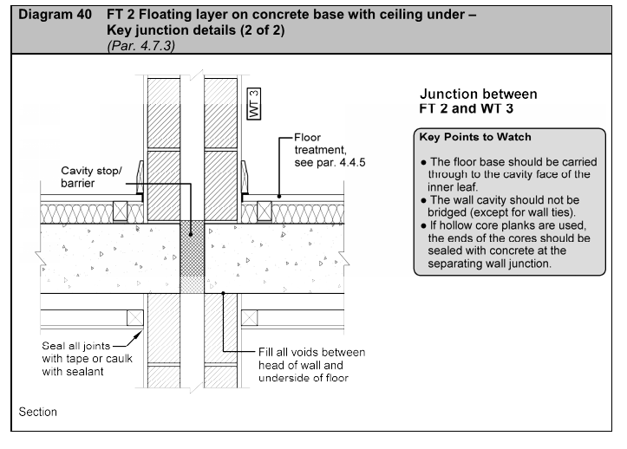
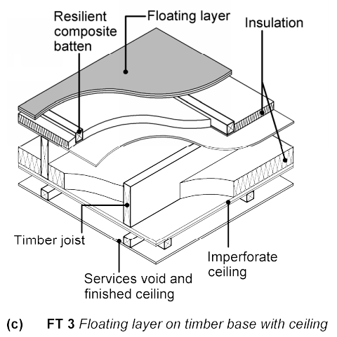
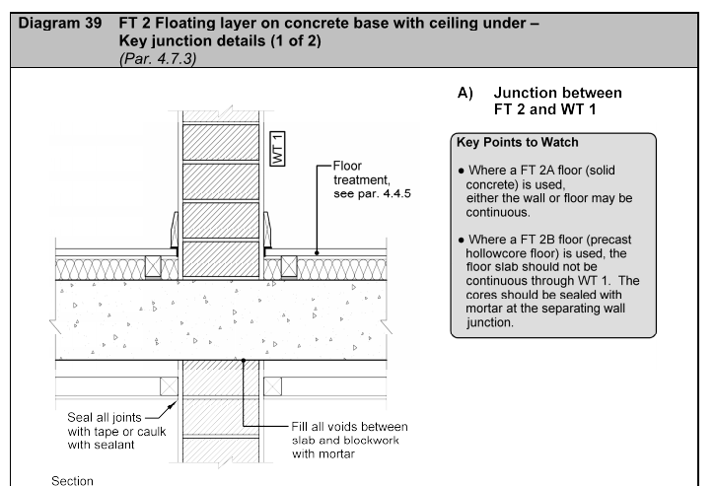
TGD-E - Assessed Certified Details (Floors)

Slide 23
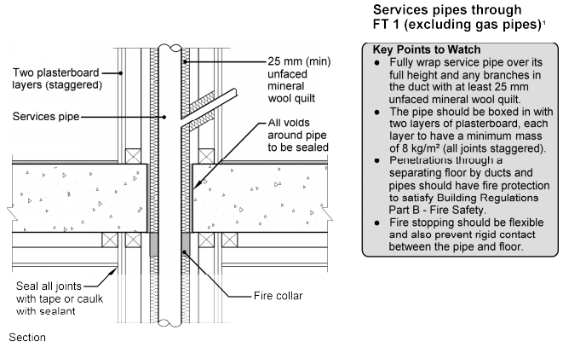
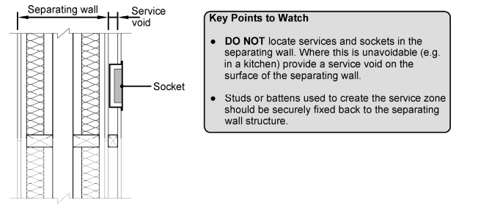
Sockets and Pipes
Sockets
Should not be back to back
Deep chases shall be avoided
Dry wall the following should be followed
Pipes (Includes Risers and Horizontal Runs)
Should be enclosed in 2 layers of plasterboard
Pipes to be lagged 25mm mineral wool
Care shall be taking when passing through the floor

Slide 24
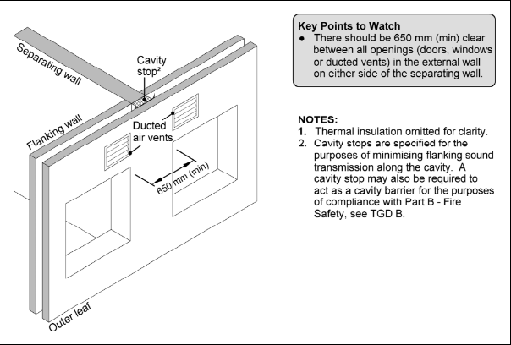
TGD-E - Example Details

Slide 25
Sound Insulation Testing

Slide 26
Testing Requirements
Certified Testers
“Sound insulation tests carried out by a person certified by an independent third party to carry out this work offers way of ensuring that such a certification can be relied upon.”

Slide 27
Testing Requirements
For each development a number of sets of tests are required.
Typical Apartment Set – Total 6 tests
Living Room to Living Room (Wall and Floor(AI))
Bedroom to Bedroom (Wall and Floor(AI))
Airborne and Impact (Total 6 tests)
Typical Attached House/Bungalow Set – Total 2 tests
Living Room to Living Room (Wall)
Bedroom to Bedroom (Wall)
Airborne (Total 2 tests)

Slide 28
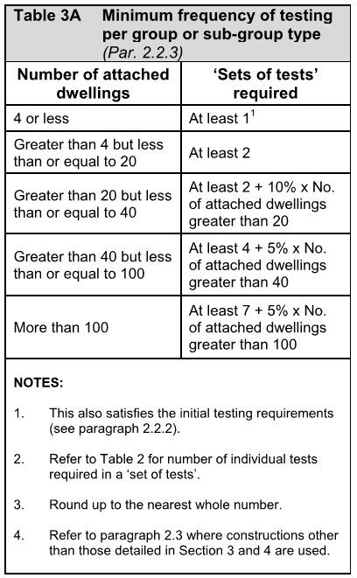
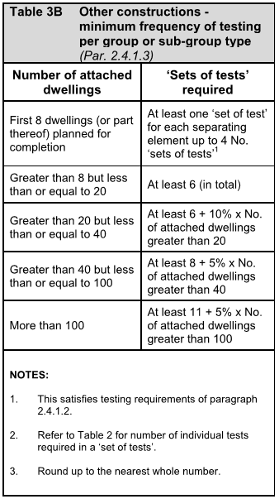
Testing Requirements – Qty of Tests
Assessed Certified Sound Details
Other Constructions
On each site, at least one ‘set of tests’ should be carried out on a dwelling group or sub-group within the first four dwellings (of that group or sub group) which are planned for completion.

Slide 29
Testing Requirements – Failed Tests
Remedial works to the failed element should be carried out until the element at least meets the performance levels when retested.
Dwellings on the same site completed prior to the failed test (excluding previous passed tests) should either have similar remedial work carried out or demonstrate by testing that they meet the required performance levels.
Where remedial work and a new test is required on any dwelling, the number of ‘sets of tests’ required should be increased by one.

Slide 30
TGD-E Requirements for Reverberation E2 & E3

Slide 31
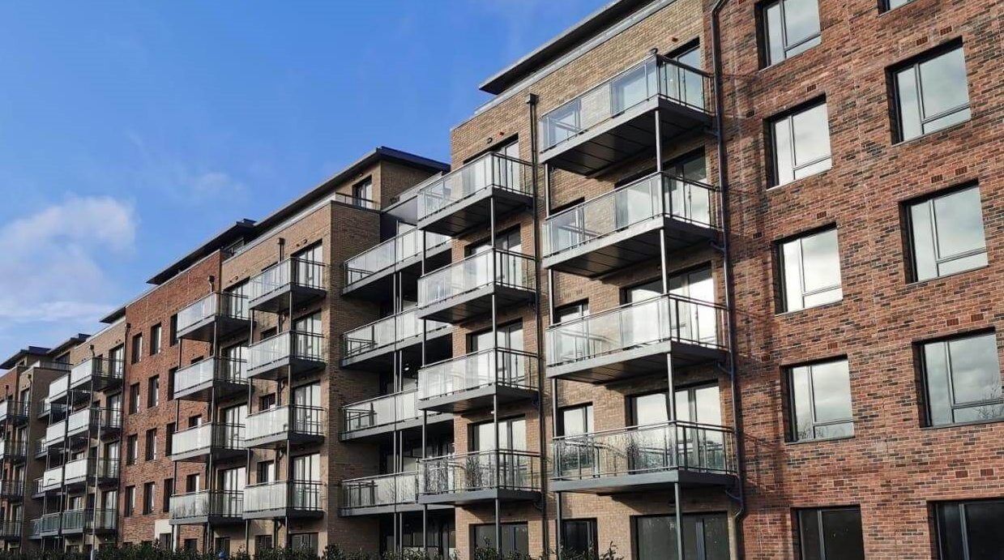
Acoustic Criteria - Reverberation
Common Areas – Direct Access to Dwelling
The purpose is to reduce noise levels in common areas.
Only applies to spaces that give direct access to apartments.
Two methods are given to demonstrate compliance
To prove compliance a report should be submitted

Slide 32
Acoustic Criteria - Reverberation
Two Methods to show compliance:
Method A – Blanket Approach
For entrance halls, corridors or hallways the absorbent material should cover an area equal to or greater than the floor area with a Class C absorber or better.
Method B – Calculated Approach
For entrance halls provide a minimum of 0.2 m² of absorption per m³ of volume.
For stairwells or a stair enclosure, the combined area of the stair treads, landings and ceiling should be covered with a Class D absorber or 50% of the area with a Class C absorber.
For stairwells or a stair enclosure, the combined area of the stair treads, landings and ceiling should be covered with a Class D absorber or 50% with a Class C absorber.
Quick and simple
More time consuming but may result reduced area of absorptive material, therefore potential overall cost savings.

Slide 33
Common Issues

Slide 34
Common Issues – Sound Insulation
Common Issues
Bridging of Floating Floor
Perimeter wall
Floor penetrations (pipes)
External wall junction detailing
Lightweight flanking walls. Head and Base details
Poor workmanship
Dot and dab plasterboard directly onto block walls.
Exposed columns/beams.

Slide 35
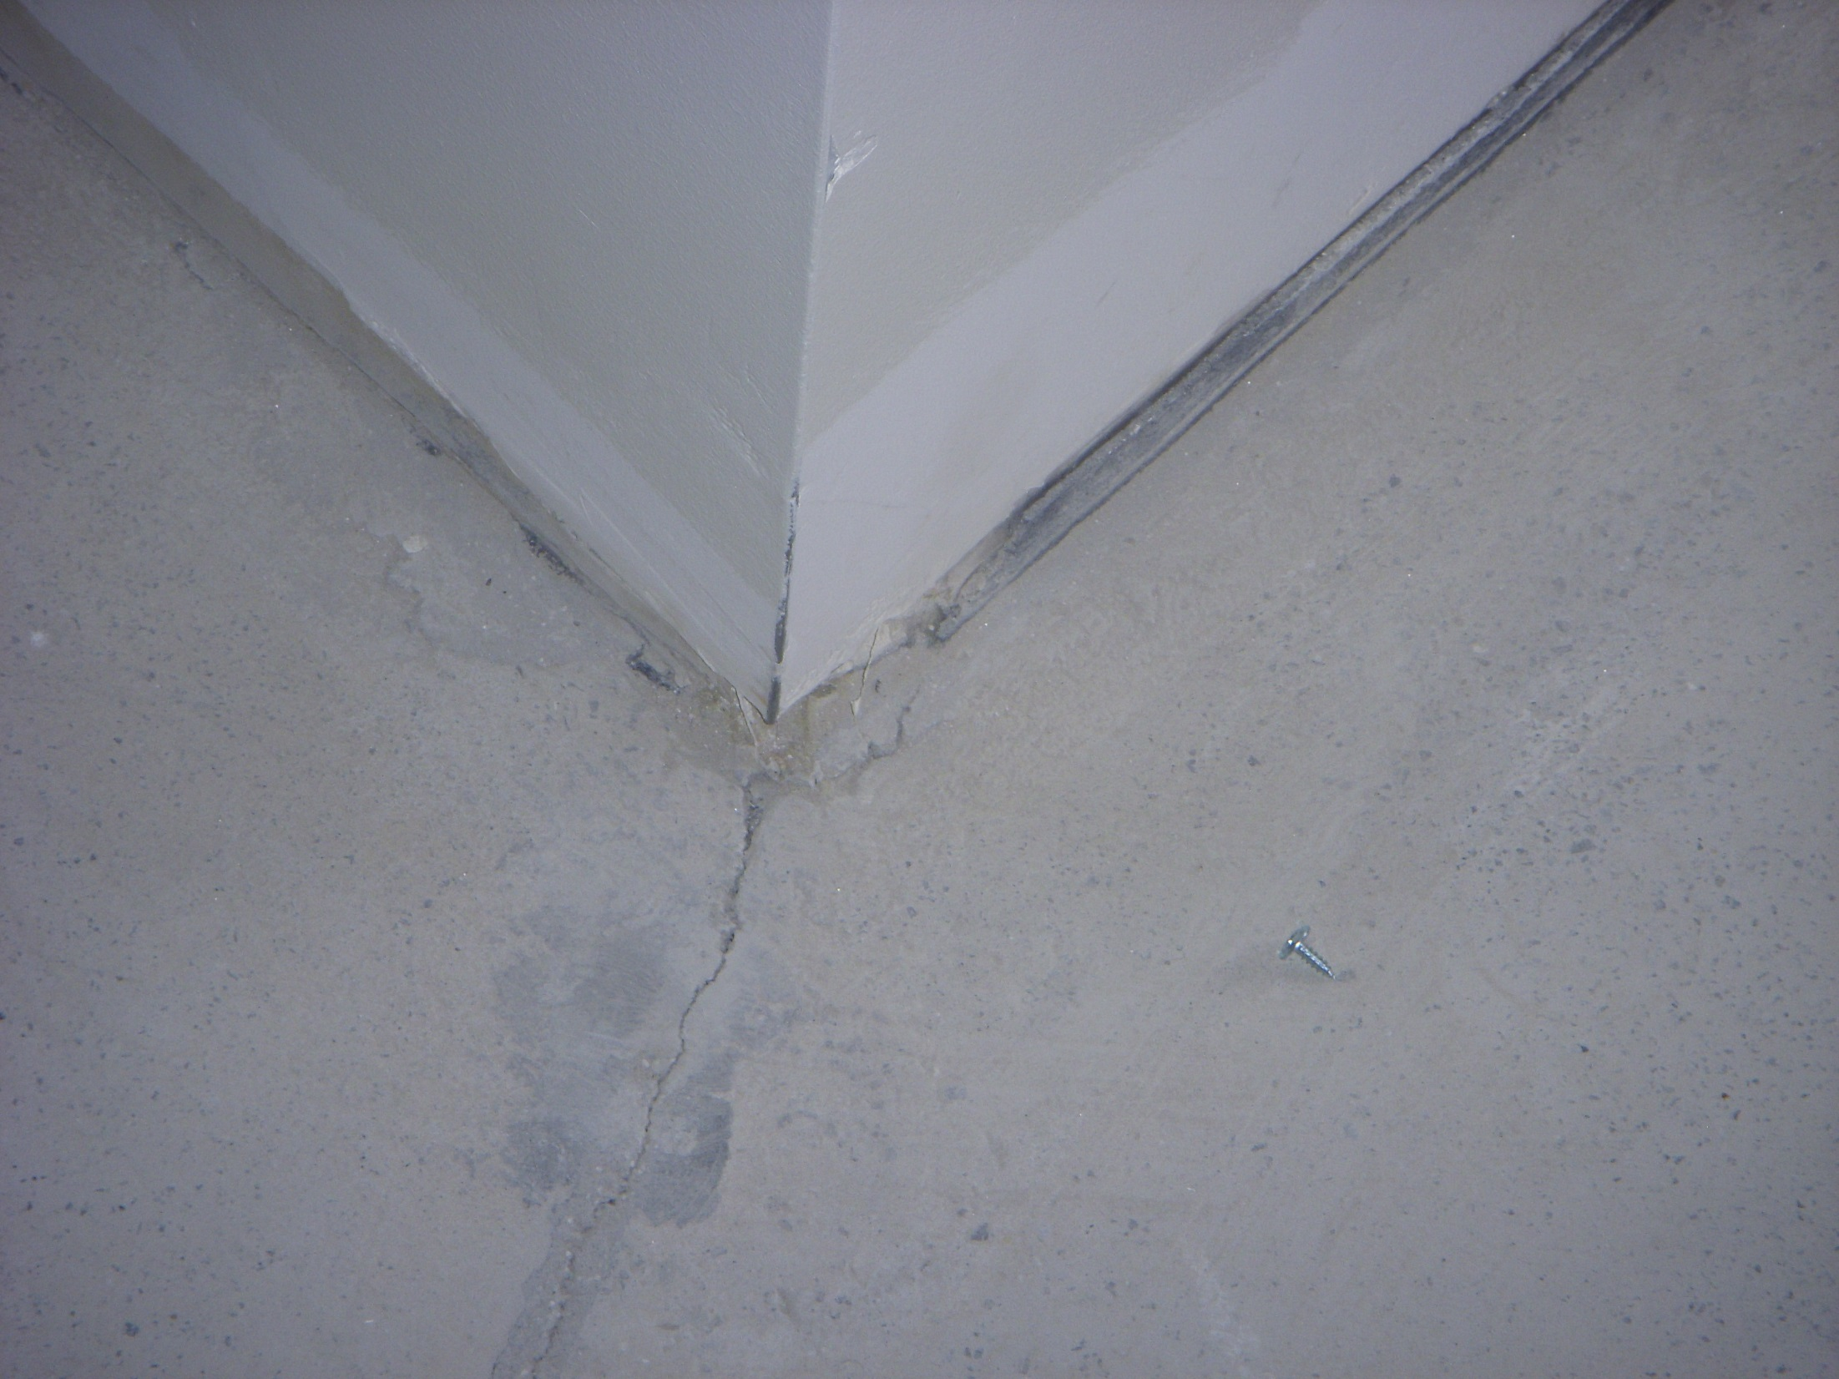
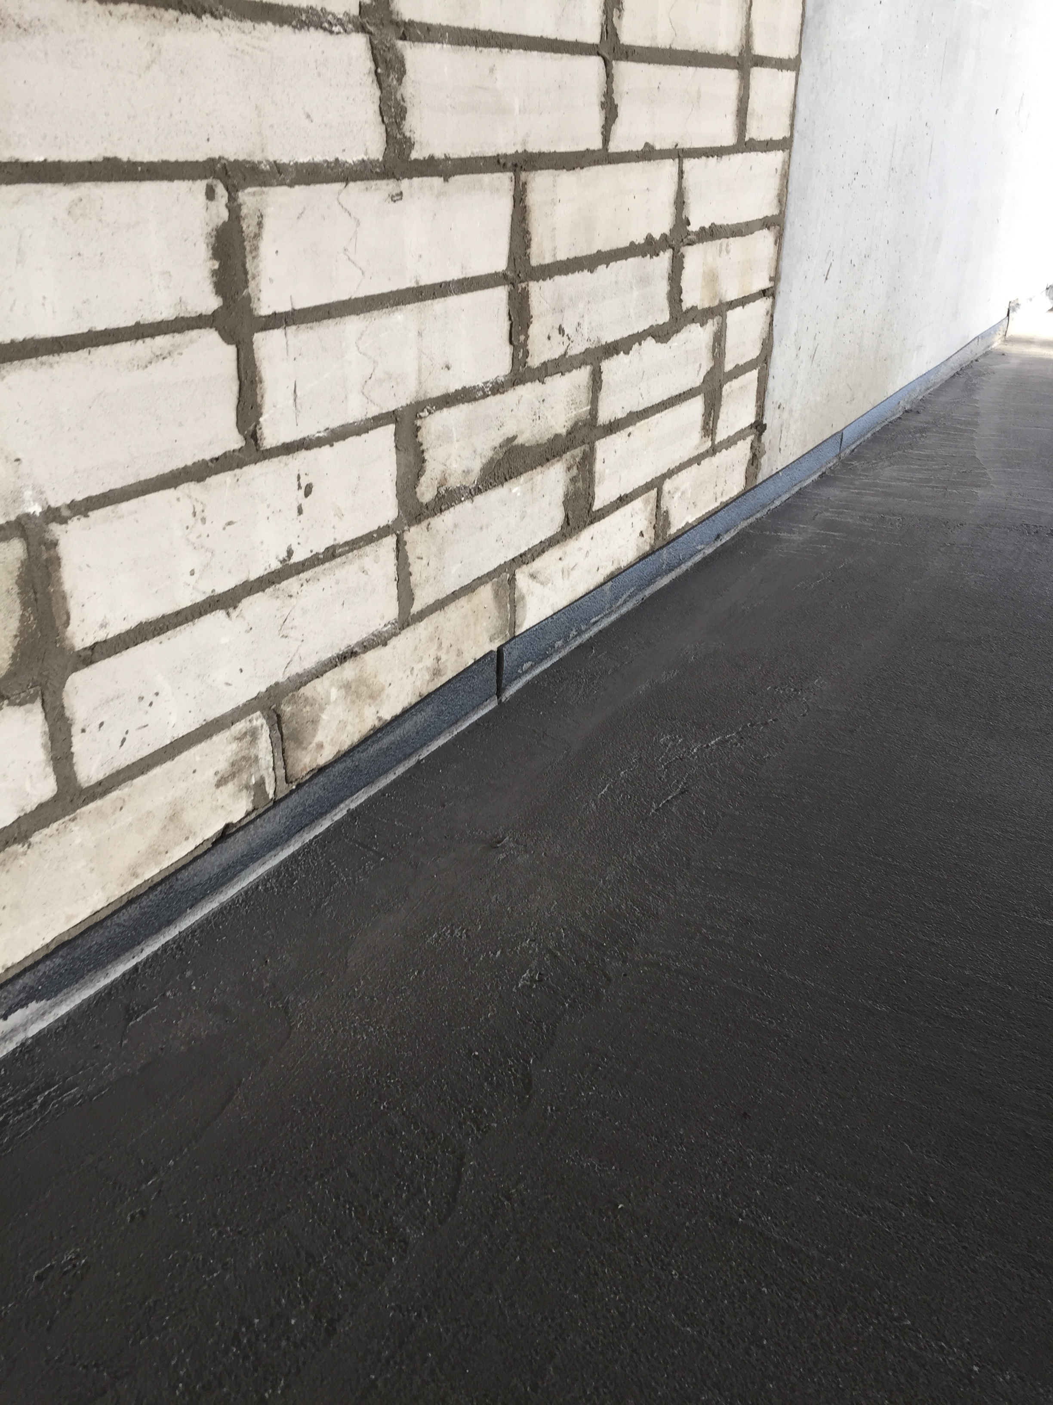
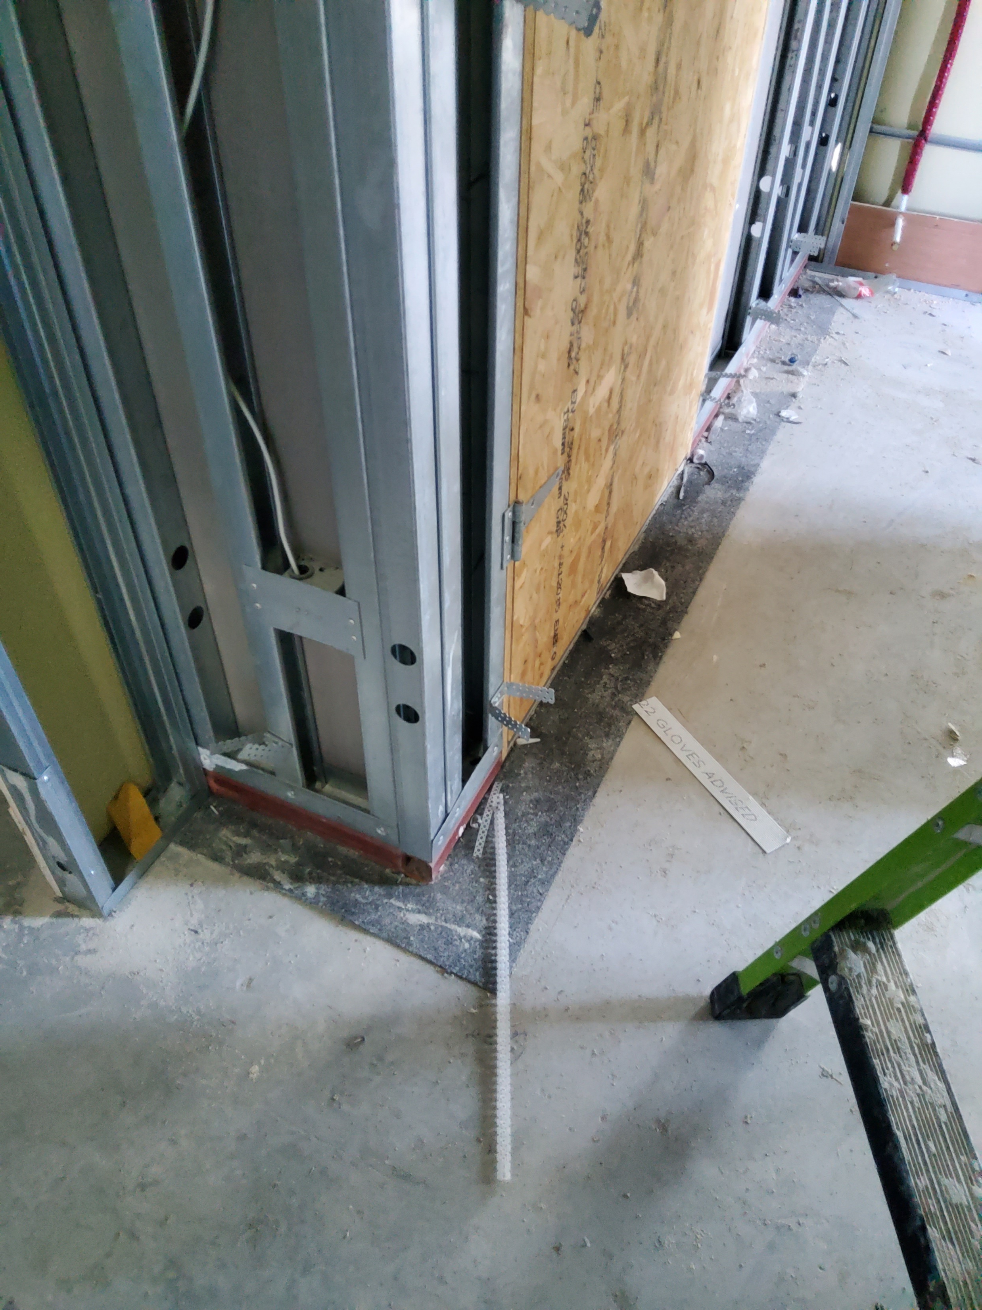
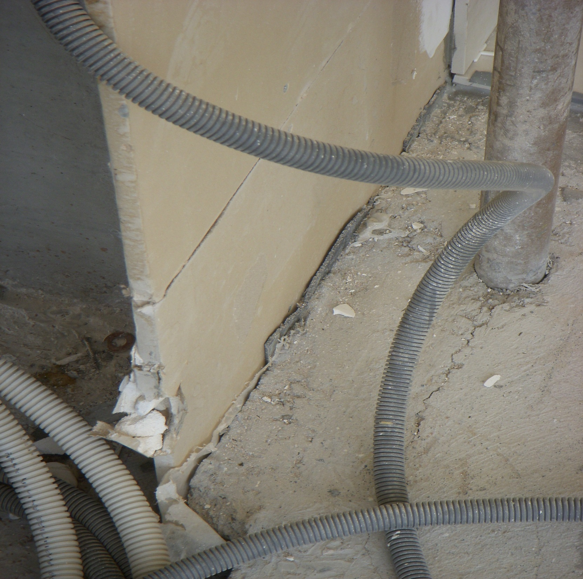
Common Issues – Resilient Layers

Slide 36
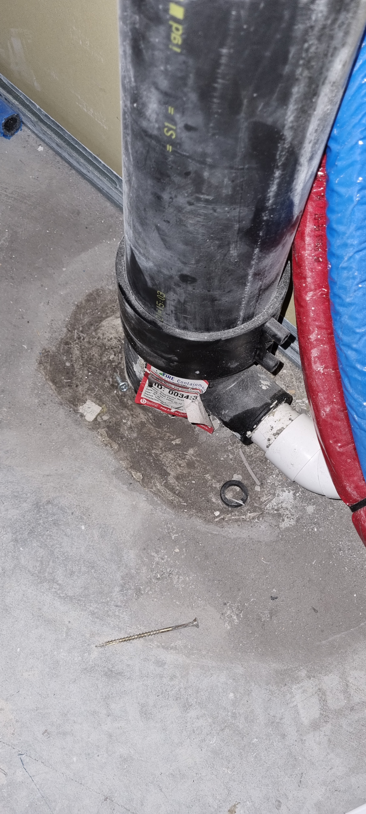
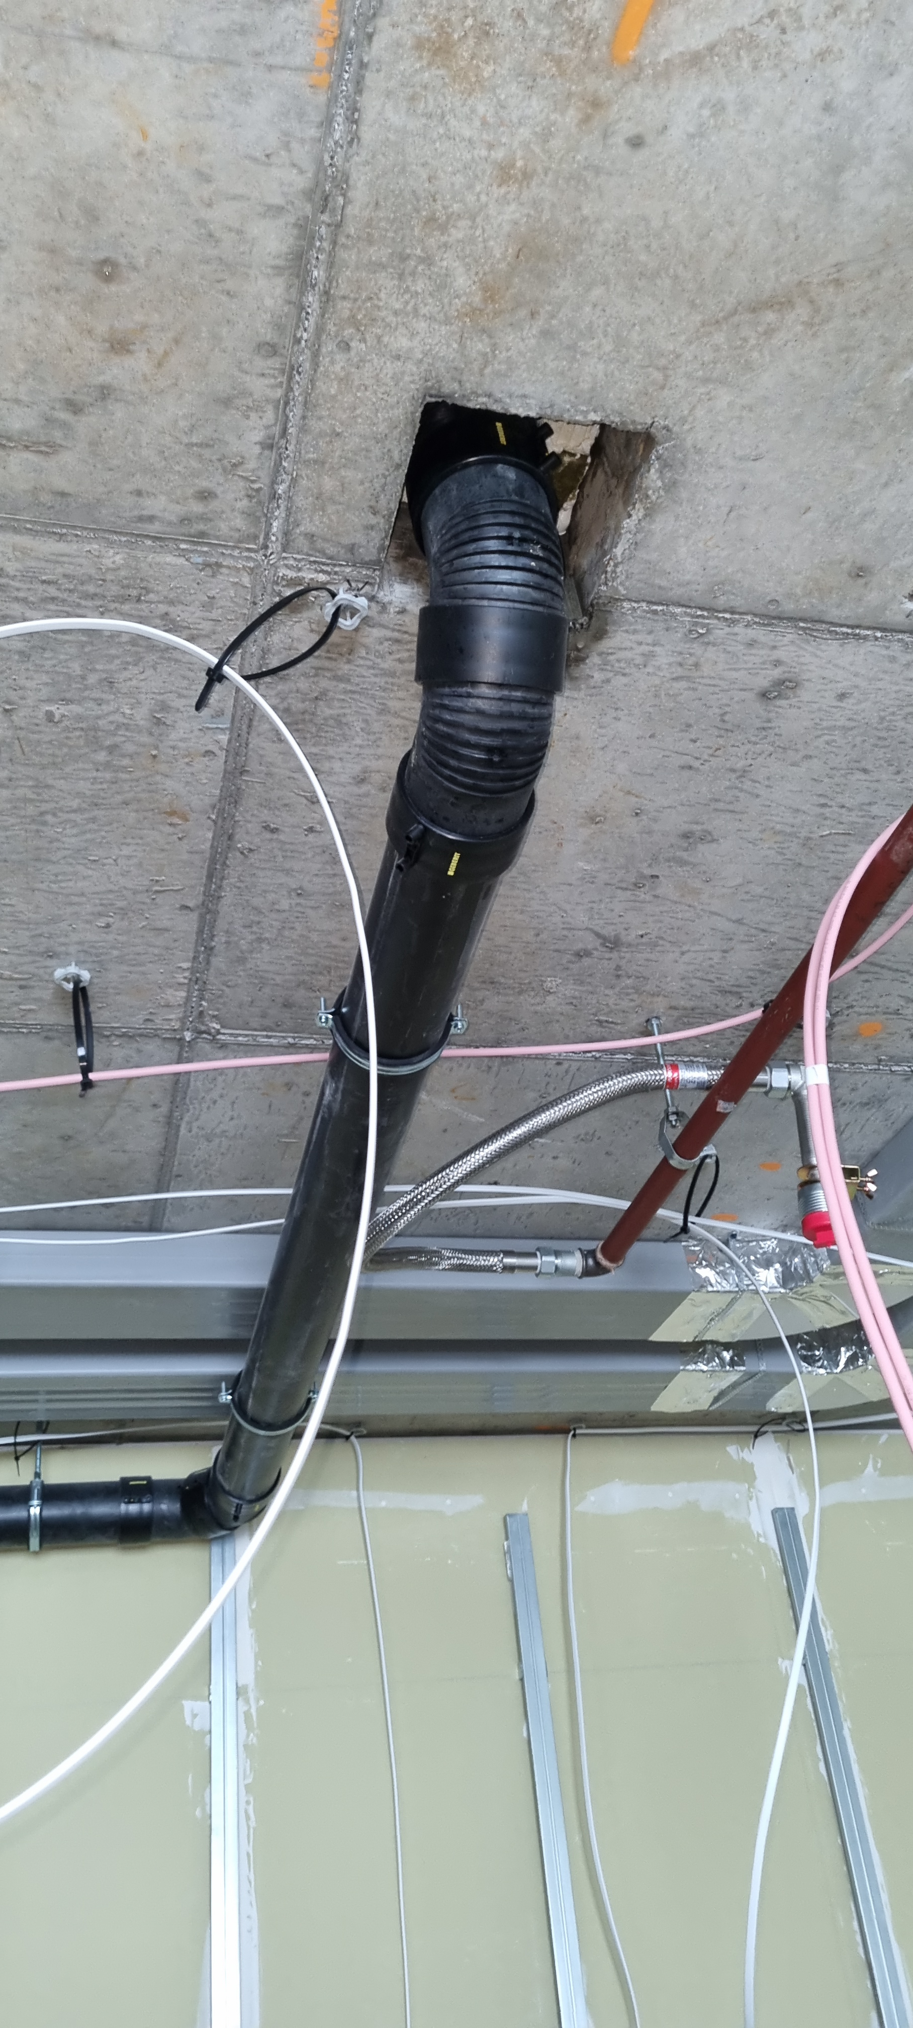
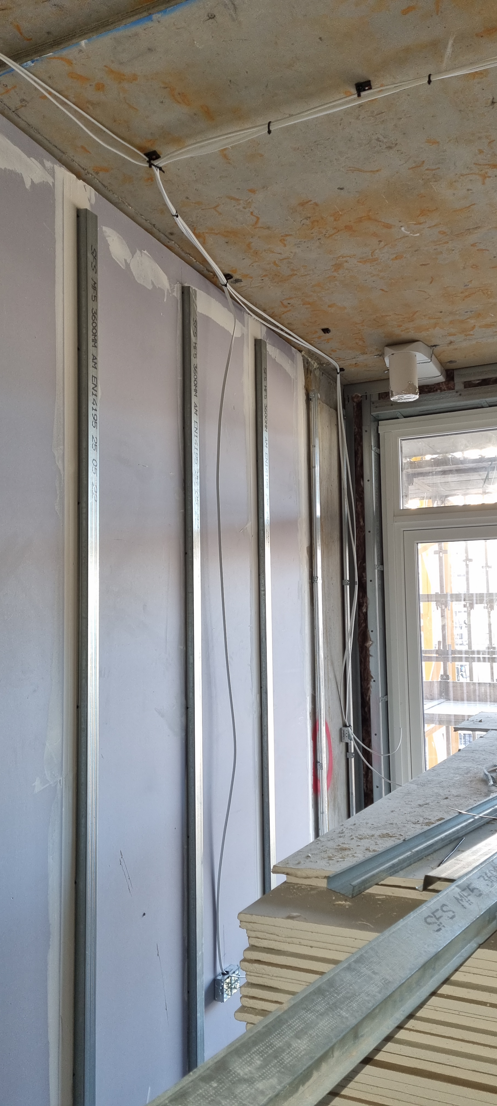
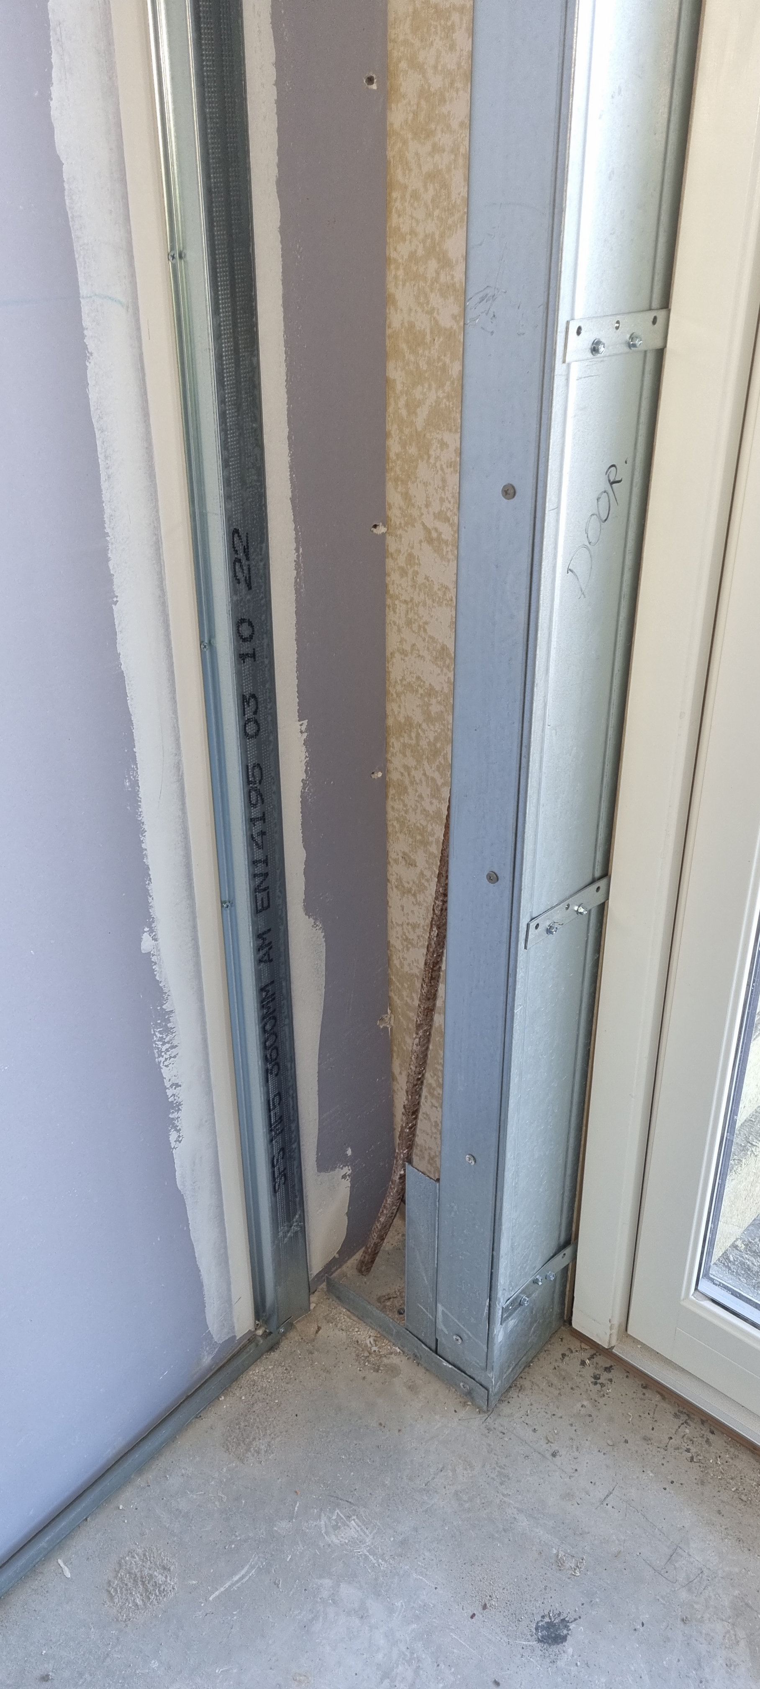
Common Issues – Pipes and Detailing

Slide 37
Building Acoustics | Sound Insulation Testing | Environmental Noise & Vibration
Thank you and any Questions?

