Slide 1



Introduction to Accounting and Finance for Chartered Surveyors
Tuesday 5th September 2023
Caroline Kirrane, CFA, MBA
Deconstructing Finance

Slide 2
Accounting: What?
Collecting, analysing and communicating financial information (transactions)
Information is used for decision-making
“The process or work of keeping financial accounts”
METHOD FOR RECORDING TRANSACTIONS
Notes:
Importance of accrual accounting in business – accrual accounting records transactions when they occur – not when the cash changes hands

Slide 3
Accounting: Why?
Accrual vs Cash Accounting
Credit Transactions
Notes:
Importance of accrual accounting in business – accrual accounting records transactions when they occur – not when the cash changes hands

Slide 4
What is Finance?
The management of large amounts of money, especially by governments or large companies n.
Provide funding for (a person or enterprise) v.
How to raise and invest funds for business
Lies at the heart of business – investing funds productively
Notes:
Lies at the heart of what business is about – taking funds from investors, using funds to invest in productive assets (equipment, buildings etc) and then returning funds to investors along with a return (extra money back)

Slide 5
Cash Flow Statement
Formula: Beginning Cash +/- Changes in Cash * EQUALS Ending Cash
Measures: Real flows of cash into and out of the business
Tells Us: If profits are backed by cash, cash flow health of business
Why?: To provide a real-world check on accrual accounting
* Ok, one small extra complication – we divide the cash inflows and outflows into three categories; operating, financing and investing

Slide 6
Usual Direction of Cash Flows
Operating activities
Cash and cash equivalents
Investing activities
Financing activities
CASH = OXYGEN

Slide 7
Usual Direction of Cash Flows
Operating activities
Cash and cash equivalents
Investing activities
Financing activities
CASH = OXYGEN

Slide 8
Cash Flow Management
Working Capital
Cost Control
Operational Gearing
Fixed vs Variable costs
Notes:
Timing AND size of cash flows are important when forecasting/budgeting cash flows

Slide 9
Income Statement / P&L Account
Formula: Revenue [Sales] LESS *Expenses [Costs] = Profit
Measures: Performance over a period of time
Tells Us: Effectiveness at generating profits, business model
[how profits made], effectiveness of management team
Why?: Because cash and profits rarely move in unison - accruals
* Ok, so there’s one small extra complication – we divide these expenses into categories

Slide 10
Income Statement – what it tells us
Effectiveness at generating wealth - profits
How profits were derived – business model
And why do we need it?
Cash and profits rarely move in unison
Notes:
To understand, analyse and interpret the income statement, we need to understand:
What is accrual accounting?
Why is accrual accounting needed in business?
What is the difference between profit and cash?
What are the categories of expenses?
Why do these categories make sense?
What is depreciation?
What do the different measures of profitability tell us?
What is the cost structure?

Slide 11
Balance Sheet
Formula: Assets LESS *Liabilities EQUALS Equity
Measures: Financial position at a point in time
Tells Us: List of what is owned and owed, how the business is financed, where funds are invested, what the business is worth
Why?: To check long-term viability of business – “going concern”
* Ok, so there’s a small extra complication – we divide assets and liabilities into categories – current vs. long-term

Slide 12
Balance Sheet
Assets Assets
_________
Liabilities OR Liabilities
Equity Equity
-
=
=
+
Notes:
Both balance sheet equations make sense

Slide 13
Balance Sheet – what it tells us
How business is financed
How funds are deployed
Assessing value/worth of business
Assessing position of business
Notes:
To understand, analyse and interpret the balance sheet, we need to understand:
What is an asset? What is a current asset? What is a tangible asset?
What is a liability? What is a current liability?
What is equity?
Why does the balance sheet equation make sense?
What are the links between the income statement and the balance sheet?
What are the common current and long-term assets and liabilities?
Why is the balance sheet used for valuation?
What is the capital structure?

Slide 14
Financial Analysis
Common Size Statements
Ratio Analysis

Slide 15
Common Size Income Statement / P&L

Slide 16
Ratio Analysis
  Profitability – ability to generate profits
  Activity – efficiency at day-to-day tasks (aka efficiency ratios, operating ratios)
  Liquidity – ability to meet short term obligations
  Solvency – ability to meet long term obligations (aka leverage ratios)
  Valuation – evaluating investment potential

Slide 17
Ratio Analysis
Company A
Income Statement
Revenue $ 100,000
Expenses $ 60,000
Net profit $ 40,000
Company B
Income Statement
Revenue $ 350,000
Expenses $ 225,000
Net profit $ 125,000
NPM = 40%
NPM = 36%

Slide 18
Ratio Analysis
Company A
Balance Sheet
Assets $ 700,000
Liabilities $ 500,000
Equity $ 200,000
Company B
Balance Sheet
Assets $ 5,000,000
Liabilities $ 2,500,000
Equity $ 2,500,000
D/E = 2.5X
D/E = 1X
RoE = 20%
RoE = 8%
RoA = 5.7%
RoA = 4%

Slide 19
Corporate Finance
How do you Fund a Business?
What is the Capital Structure?
What is Time Value of Money?
Notes:
Corporate Finance is the area of finance that preoccupies itself with how to raise funds (from debt or equity) and how to deploy funds (valuing assets)
The capital structure of a business is the proportion of debt and equity it is using to finance itself. How it’s assets are financed.

Slide 20
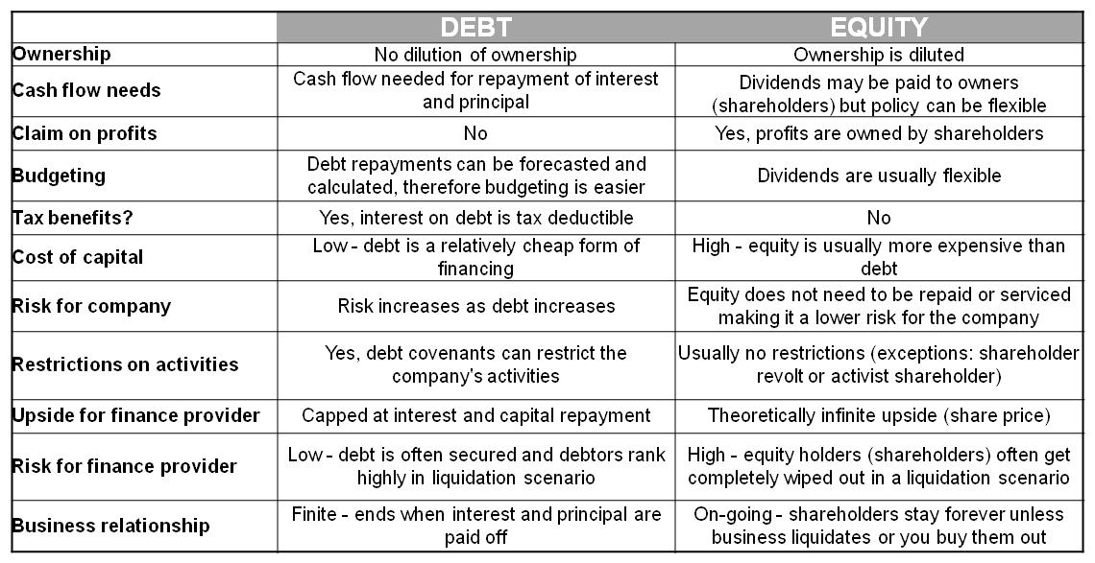
Debt and Equity
Notes:
Debt and equity have different characteristics and downsides and using both together can reduce the downsides of each

Slide 21
Capital Structure
% Debt + % Equity
Notes:
Corporate Finance is the area of finance that preoccupies itself with how to raise funds (from debt or equity) and how to deploy funds (valuing assets)
The capital structure of a business is the proportion of debt and equity it is using to finance itself. How it’s assets are financed.

Slide 22
What is Time Value of Money
≠
MONEY NOW
MONEY LATER
Why?
Opportunity cost – could have invested and earned interest
Risk – may not get it in future – default risk, flight risk
Inflation – goods in the future are likely to be more expensive than today
Implications
We cannot simply add together amounts of money related to a project when cash flows happen at various points in the future because they are not equivalent
Need tools to help – NPV, IRR
Notes:
Corporate Finance is the area of finance that preoccupies itself with how to raise funds (from debt or equity) and how to deploy funds (valuing assets)
The capital structure of a business is the proportion of debt and equity it is using to finance itself. How it’s assets are financed.

Slide 23
Time Value of Money
Present value of £1 receivable at various times in the future, assuming an annual financing cost of 20%
100
£1
90
80
70
60
Pence
50
40
30
20
10
0
1
2
3
4
5
6
7
8
9
10
Years into the future
Source: Atrill and McLaney
Notes:
Corporate Finance is the area of finance that preoccupies itself with how to raise funds (from debt or equity) and how to deploy funds (valuing assets)
The capital structure of a business is the proportion of debt and equity it is using to finance itself. How it’s assets are financed.

Slide 24
Thank You
Q&A

Slide 25

Dating back to 1895, the Society of Chartered Surveyors Ireland is the independent professional body for Chartered Surveyors working and practicing in Ireland.
Working in partnership with RICS, the pre-eminent Chartered professional body for the construction, land and property sectors around the world, the Society and RICS act in the public interest: setting and maintaining the highest standards of competence and integrity among the profession; and providing impartial, authoritative advice on key issues for business, society and governments worldwide.
Advancing standards in construction, land and property, the Chartered Surveyor professional qualification is the world’s leading qualification when it comes to professional standards. In a world where more and more people, governments, banks and commercial organisations demand greater certainty of professional standards and ethics, attaining the Chartered Surveyor qualification is the recognised mark of property professionalism.
Members of the profession are typically employed in the construction, land and property markets through private practice, in central and local government, in state agencies, in academic institutions,
in business organisations and in non-governmental organisations.
Members’ services are diverse and can include offering strategic advice on the economics, valuation, law, technology, finance and management in all aspects of the construction, land and property industry.
All aspects of the profession, from education through to qualification and the continuing maintenance of the highest professional standards are regulated and overseen through the partnership of the Society of Chartered Surveyors Ireland and RICS,
in the public interest.
This valuable partnership with RICS enables access to a worldwide network of research, experience and advice.
www.scsi.ie
Society of
Chartered Surveyors Ireland
38 Merrion Square,
Dublin 2, Ireland
Tel: + 353 (0)1 644 5500
Email: info@scsi.ie

