Slide 1

PUBLIC PROCUREMENT
A BEGINNER’S GUIDE
Tuesday 12th September 2023
©Bid Services 2023

Slide 2
YOUR TRAINER
Roisin Mallon
2002-2008: Tata Consultancy Services
2008-2011: Parity Solutions, Parity Recruitment
2011-2016: Attenda Ltd. (Now Ensono)
2016 to date: Bid Services
APMP Chair, Ireland
Accredited APMP Trainer
APMP Global 40 under 40 for contribution to industry

Slide 3
TENDER TRAINING
EXCELLENCE PROGRAMME
Access (for free) on www.bidservices.ie
Nine eLearning modules cover:
Winning Bid Strategy | Effective Bid Management | The Procurement Rules
Information Sources | Bid/No Bid Process | Tender Submissions
De-briefings | Collaborative Bidding | Targeting International Tenders

Slide 4
TODAY’S OBJECTIVES
Understand the Benefits of Public Procurement
Learn some of the jargon
Find the right tender for you
Understand the process
Hints and Tips along the way
Potential Pitfalls

Slide 5
PUBLIC PROCUREMENT
PUBLIC PROCUREMENT IS….
…..the process by which public bodies (called contracting authorities) purchase works, goods or services from suppliers (contractors) which they have selected for this purpose by way of a competitive tendering process
Notes:
This presentation is based on our new-book ‘Public Procurement: Rules of the Road’.
I really encourage you to get a copy – either in hard copy or as an e-book – as it provides an A to Z perspective of the tendering and procurement environment in Ireland and NI.

Slide 6

WHY TENDER?
The public sector market in Ireland (supplies, services and works) is worth at least
€17 billion per annum
Procurement is a key priority in the Programme for Government

Slide 7
THE BASICS
All bodies receiving Exchequer funding (including charities for example) must procure by way of a competitive tender: this is done on eTenders.
The higher the contract value the more complicated the procedures/processes used.
EU Procurement Directives set the rules.
Guidelines published to help buyers and suppliers.
System is very transparent.
The Office of Government Procurement (OGP) is the de facto regulator.
Majority of tender opportunities by volume are under €25,000.

Slide 8
WHAT IS TENDERING?
Tendering is the process of making an offer, bid or proposal, or expressing interest in response to an invitation, call or request for tender.
Organisations will seek other businesses to respond to a particular need, such as the supply of goods and services, and will select an offer or tender that meets their needs and provides the best value for money.

Slide 9
KEY MESSAGES
To be a player you need:
To fully understand the policy, legal and regulatory framework.
To target and prioritise the tender pipeline for your company.
To fully understand buyers’ procurement rules and procedures.
To research new opportunities in detail before tendering.
To decide if you need bid partners.
To up-skill your tendering techniques.

Slide 10
Contracting Authorities/Buyer
….defines the WHAT, WHERE and WHEN
Contract
….sets out the requirements and specifications
Tenderers/Suppliers/Contractors
….provide the HOW in their tender response
Notes:
This presentation is based on our new-book ‘Public Procurement: Rules of the Road’.
I really encourage you to get a copy – either in hard copy or as an e-book – as it provides an A to Z perspective of the tendering and procurement environment in Ireland and NI.

Slide 11
WHAT IS TENDERING?
Tendering is the process of making an offer, bid or proposal, or expressing interest in response to an invitation, call or request for tender.
Organisations will seek other businesses to respond to a particular need, such as the supply of goods and services, and will select an offer or tender that meets their needs and provides the best value for money.

Slide 12
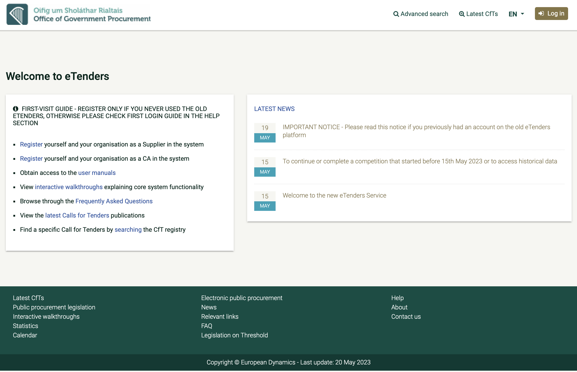
Register on ETENDERS

Slide 13
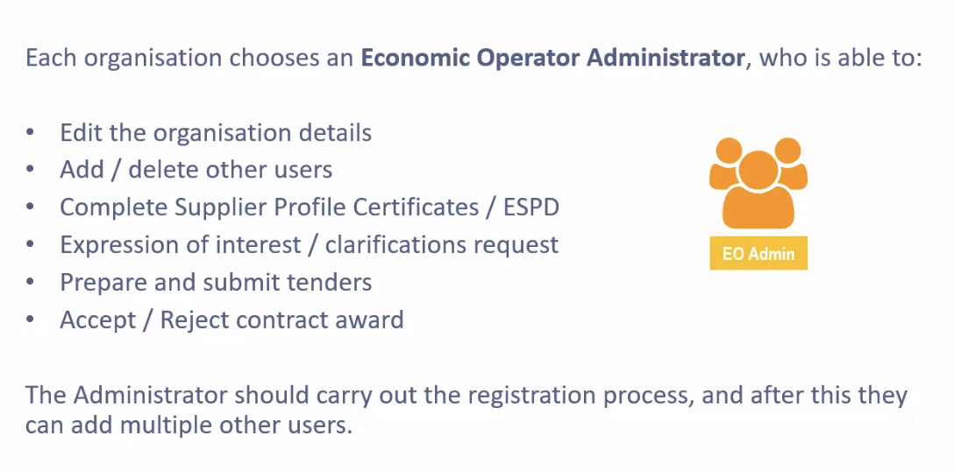
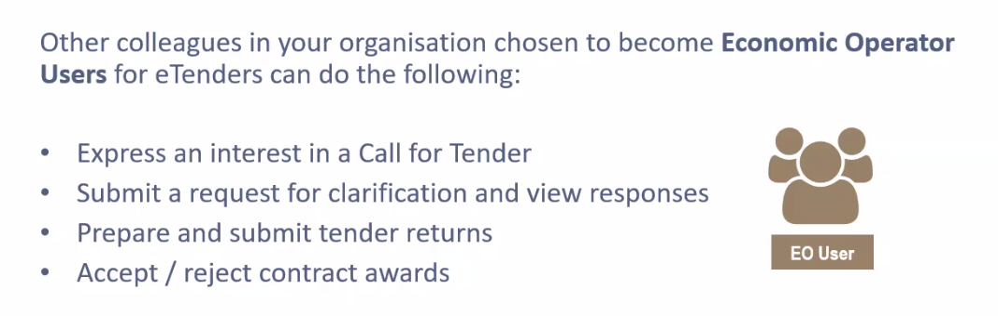
WHO REGISTERS?

Slide 14

GETTING STARTED
And Consult User Guide
READ INFORMATION NOTE DATED 19 MAY ON HOME PAGE
LISTEN TO OGP TUTORIAL: https://www.etenders.gov.ie/epps/walkthrough/en/EO_B1.h
(Does not work on Safari)

Slide 15
PUBLIC AND PRIVATE PROCUREMENT
There are significant differences of approach and methodology.
Public procurement is rules based.
There are no legal rules in the private sector; best practicing sourcing techniques are used.
Know and appreciate the differences.

Slide 16
THE JARGON
RFI, EOI, PQQ
CFT, RFP, RFT, ITT
BAFO
Presentation

Slide 17
TERMS/ABBREVIATIONS IN ETENDERS
 | Acronym
ECONOMIC OPERATOR | EO
CALL FOR TENDER | CfT
CONTRACTING AUTHORITY | CA
PROCUREMENT OFFICER | PO
WORKSPACE | WS
FRAMEWORK AGREEMENT | FA
CENTRAL CERTIFICATE AUTHORITY | MANAGES EO’S CERTIFICATES

Slide 18
TENDER COMPETITION TYPES
TENDER TYPES | DESCRIPTION
RFI / EOI / PQQ | STAGE 1 GENERAL COMPANY INFORMATION / CREDENTIALS
CFT/RFT/RFP/ITT | STAGE 1 / STAGE 2 GREATER DETAIL COMBINATION OF SELECTION/ AWARD CRITERIA BASIS OF A CONTRACT
BAFO | OPTIONAL STAGE BEST AND FINAL OFFER
PRESENTATION | OPTIONAL STAGE PRESENTATION OF TENDER SUBMISSION
FRAMEWORK | SINGLE / MULTIPARTY COMBINATION OF SELECTION AND AWARD CRITERIA RATE CARD PRICING NO GUARANTEE OF WORK
DPS | OPEN, FLEXIBLE FRAMEWORK RATE CARD PRICING

Slide 19
BID /
NO BID –
SIMPLIFIED

Slide 20
NO BID IF
You are going through the motions.
Risks are too high.
You cannot fulfil all the qualification and technical requirements.
Cannot price the requirements.
No relevant experience.
Disruptive effective on other parts of the business.
Lack the scale or skills required.

Slide 21
WHY BIDS FAIL
Failure to carry out a Bid/No Bid assessment.
Not enough detail provided; material too generic.
Too expensive.
Bids are non-compliant; documentation incomplete.
Award criteria not fully addressed.
Sloppy presentation and poorly written material.

Slide 22

COMPLIANCE
If the buyer asks you to submit your proposal whilst standing on your head….
Practice standing on your head.

Slide 23
COMPLIANCE
Tenderers are required to submit quotes for this work by hand to (address) as soon as possible as we are keen to get started.
(Small scale Construction tender, 2023)
Potential Suppliers should submit 2 no. hard copies of their tender in separate plain envelopes with no identifying information on the outside.
(Window Cleaning Tender, 2022)

Slide 24
COMPLIANCE
Tenderers are required to provide evidence of…….
Potential Suppliers should ensure that documents are signed in blue ink.
(Architectural Services Tender)

Slide 25
ASK CLARIFICATION QUESTIONS
Always ask a question if the RFT is not clear.
Really important that you have clear guidance about price and how it will be evaluated.
Buyers required to provide suppliers with adequate responses.
Be careful how questions phrased.
Responses provided to all tenderers.

Slide 26
THE BIDDING PROCESS
EXPRESSION OF INTEREST
STAGE 1 SUBMISSION
SHORTLISTING?
STAGE 2 SUBMISSION
PREFERRED SUPPLIER NOTIFICATION
STANDSTILL
CONTRACT AWARD

Slide 27
THE SEVEN DEADLY SINS OF BID WRITING
You use generic brochure material and fail to focus on the buyer’s specific requirements.
The document becomes an information dump with no structure.
Your USPs are not clearly spelled out.
Key points are buried in numerous appendices.
The document is full of jargon.
Multiple misspellings, grammar and punctuation mistakes remain unchecked.
You use the incorrect name for the buyer.

Slide 28
ADDRESSING THE REQUIREMENTS
The key messages usually relate to:
Solution: Given the problems/opportunities set out in the RFT, what is needed?
Method: Given that need, how should the solution be delivered?
Suitability: Given the proposed methodology, who will deliver and why is this team selected for this task?
Benefits: Given these methods and your suitability for the task, what measurable benefits will the client accrue?

Slide 29
WRITE TO THE EVALUATORS
It is important to keep in mind that the people who will read your bid response and allocate the marks have only the page in front of them to judge you; so use their language not yours.
Use plain English and keep it simple.
Assume the evaluators know absolutely nothing about you and your business.
While it will be essential to address technical issues, remember that non-technical staff will be required to read these sections.

Slide 30
BUYER’S PERSPECTIVE
Put yourself in the position of the evaluator.
Would you be exhausted having read a hundred pages of a bid response clearly written by several different authors which is full of jargon, spelling and grammatical mistakes and formatting issues?
Or would you allocate more marks to a bid response document that flows, is and looks coherent, reads well and has a uniform style?

Slide 31
SOME BASIC RULES
Sentences should be short and should contain a statement that can stand on its own
Use active (short) sentences as the language is more persuasive, dynamic, decisive and confident
Delete hyperbole from your draft material; drop every ‘very’, ‘best’ and ‘great’. Quantify.
Name the client by name in every appropriate instance; do not use the generic term ‘client’ in what should be a bespoke bid response.

Slide 32
Q&A
Discussion

