Slide 1
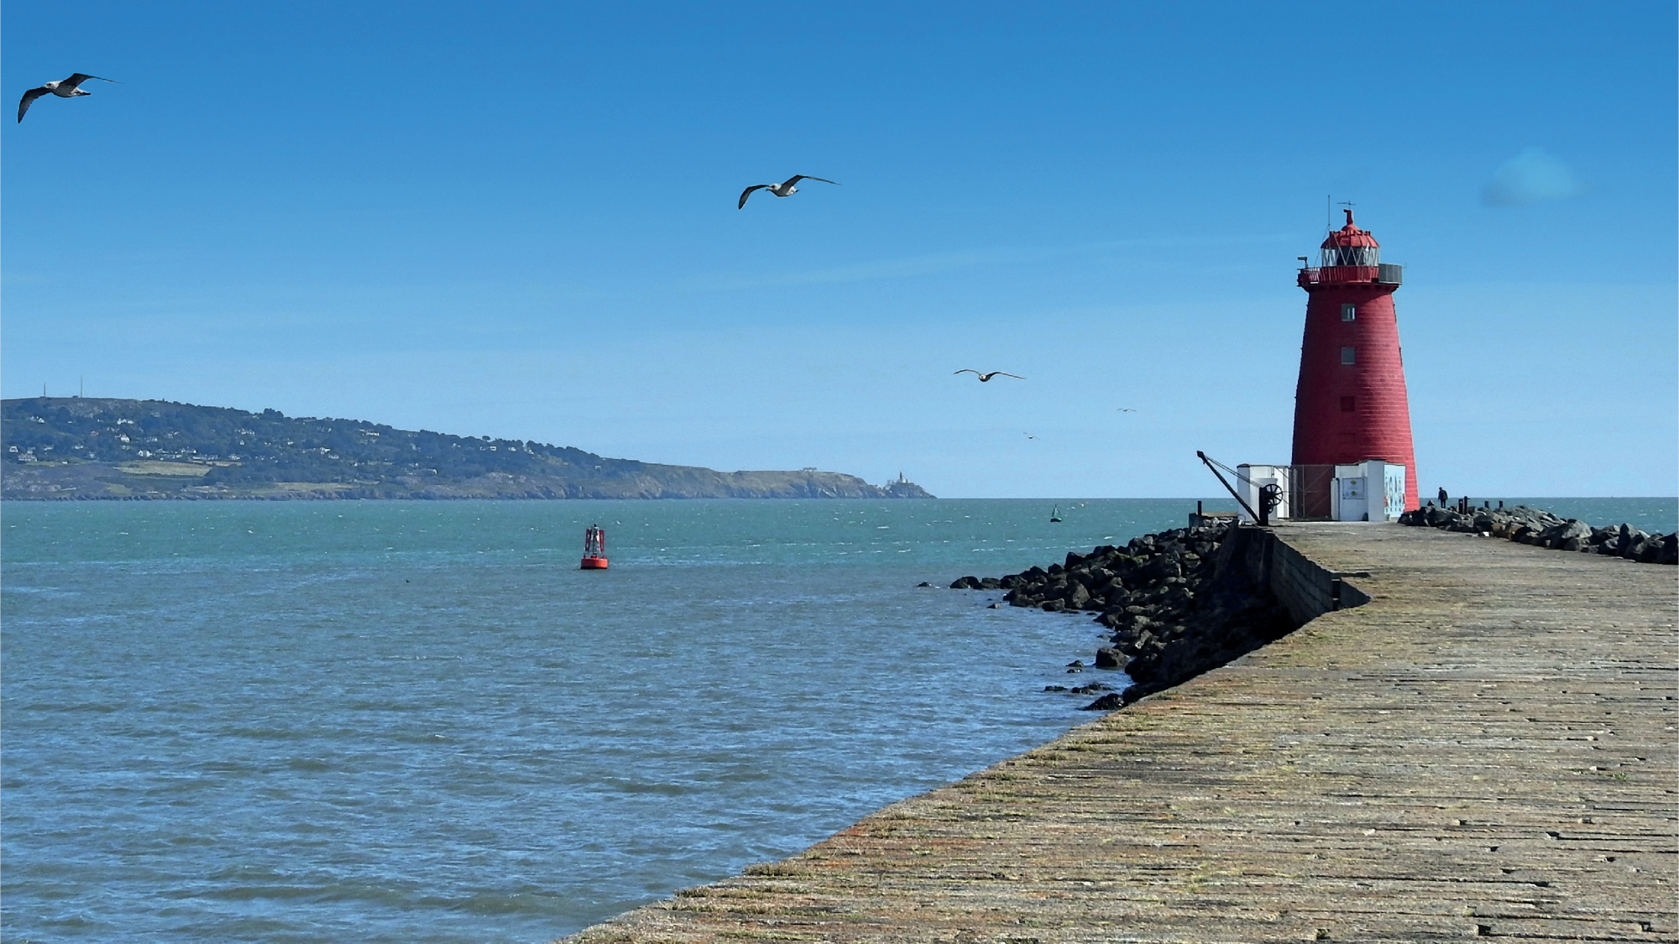
Presentation to the
Society of Chartered Surveyors on
Dublin Port - Past, Present, Future
23rd November 2023

Slide 2
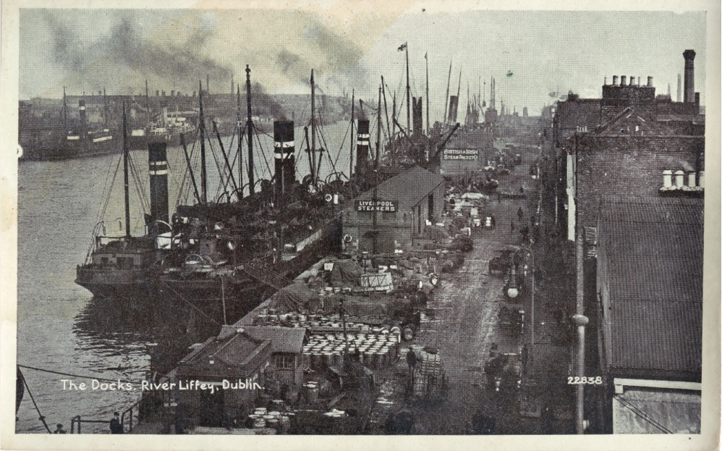
Dublin Port Past
Dublin City and Port exists because of its naturally occurring deep water not available anywhere else on the East Coast.
The Vikings discovered this 1,000 years ago.
300 years ago work commenced on the Great South Wall and the North Bull Wall to further deepen the channel and afford protection to large vessels.

Slide 3
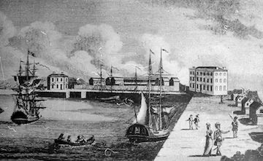
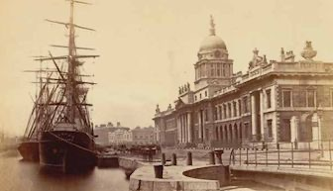
Dublin Port has moved eastwards towards deeper water and facilitated city development
North Lotts, South Lotts, IFSC, South Docklands ……
GSW 1753 and Poolbeg lighthouse 1767
New Custom house 1790s
1820s – Georges Dock
1825 North Bull Wall
1836 – 1870s – North Wall
1950s-1960s – Container traffic

Slide 4
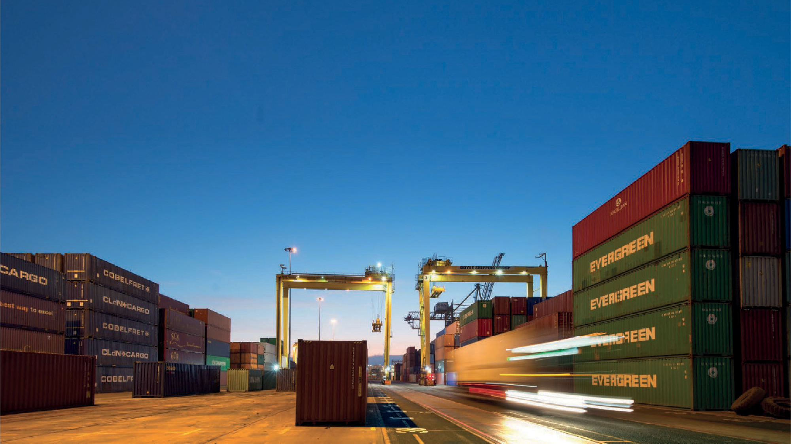
Who are we?
A self financed semi state company
Approx 155 employees
Commerical Team and Project Management office
Engineering team
3 surveyors in Commercial team
6 engineers in Engineering team
8 engineers and 6 surveyors in PMO

Slide 5
As a small island economy, Dublin Port is a critical enabler of Ireland’s economic growth.
90%
of all goods into and out of Ireland move through our ports.
85%
Less emissions – Marine freight
versus Air freight.

Slide 6
Dublin Port accounts for 79% of containerised trade
 | Containerised |  | Bulk
 | RoRo | LoLo | Bulk Liquid | Dry Bulk
Dublin | 83% | 72% | 37% | 12%
Cork | 1% | 24% | 49% | 8%
Rosslare | 16%
Waterford |  | 4% |  | 9%
Galway |  |  | 3% | 1%
Shannon/Foynes |  |  | 11% | 56%
Drogheda/Greenore/New Ross |  |  |  | 14%
Source: IMDO

Slide 7
79%
Dublin Port
Dublin Port accounts for 79% of containerised trade
68% of all containerised trade with the EU comes through Dublin Port.
14% Rosslare | 15% Cork
2% Waterford
91% of all containerised trade with the UK comes through Dublin Port.
7% Rosslare | 3% Cork
1% Waterford
10%
Rosslare
2%
Waterford
9%
Cork

Slide 8
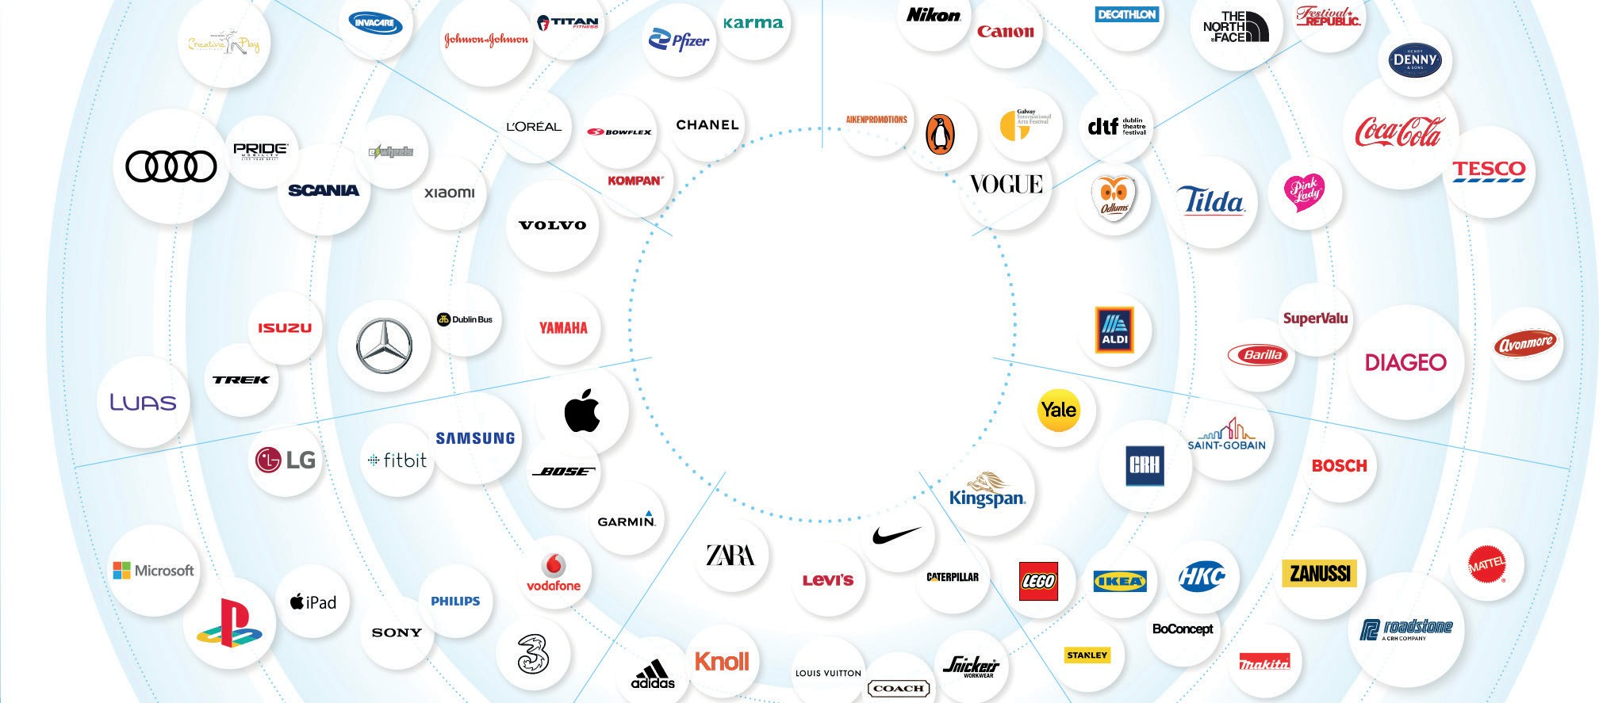
Dublin Port is THE gateway for Irelands export business
60%
43% of the value of our exports relies on imports from overseas.
(3 times EU average and 5 times OECD average)
40%
Exports have 3.5 times higher value than imports.
Source: OECD
Source: CSO Statistics

Slide 9
Dublin Port is THE gateway for Irelands export business
Up to €40bn of trade flows through Dublin Port each year.

Slide 10
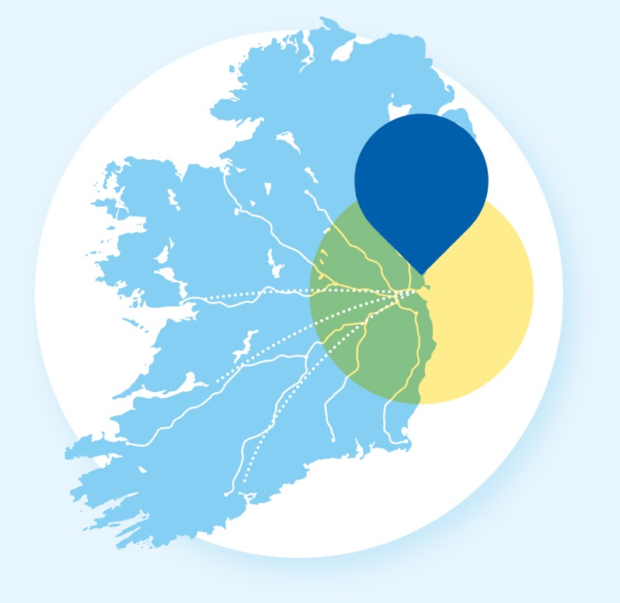
Not just a port.
A World-Class Route-to-Market System
Dublin Port, Dublin Port Tunnel, the M50 and the National Motorway link to create a world class route-to-market system.
Replicating the infrastructure of Dublin Port and the supporting route-to-market is a mega- project requiring billions of euros. Other potential port options are over 100km from the main centre of population.
73% of all volume to and from the Port emanates from within 90km of the Port.

Slide 11
The Development of Dublin Port
We must finance our own projects
Multiple, major infrastructure projects delivered on time and within budget
€500m Investment since 2012
€1bn CapEx programme by 2028
Directly supports 4,500 jobs

Slide 12
Masterplan 2040 – Building Port Capacity
Enabling International Trade
Southern Port
Access Route
Plot K
RORO Area
Plot N
Export Area
Plot O
Import Area

Slide 13
Masterplan 2040 – 3FM Ready to Go
SPAR Bridge Removing all commercial traffic from public roads
Southern Port
Access Route
Relocation of LoLo area from K to N
Plot K
RORO Area
Plot N
Export Area
Plot O
Import Area
Planning for 3 high stack only

Slide 14
NEW SOUTHERN PORT ACCESS ROAD (SPAR)
Removes all HGV Traffic from public roads
Services all commercial traffic within Port & Poolbeg peninsula
Provides safe transit to pedestrians & cyclists
Allows for light rail expansion
Notes:
This opening bridge (which wont open as fast as this) and road will take all of the heavy goods and public transport traffic off the Tom Clarke bridge. For Dubliners and locals alike this is going to a huge benefit. For those involved in transport this is critical to the movement of heavy traffic from the poolbeg peninsula.

Slide 15
3FM – Proper planning & sustainable development
Lands ceded to active travel, maritime village & park, utilities and nature reserve equivalent to 1/3 of commercial lands
3 Core Objectives
Increase capacity
Restructure port operations
Investment in public realm
Maritime Village 1.6Ha
Land to Codling for on-shoring ORE 1.6Ha
Active Travel & Walkways 5.5km
K
12.6Ha
N
9.1Ha
Port Park 1.4Ha
5G Pitches / Dog Run
District Heating Scheme & utilities for Glass Bottle Housing Development 1Ha
O
5.9Ha
Area for potential Wilding / Interpretative centre 1Ha
Sean Moore Walkway 2.5Ha

Slide 16
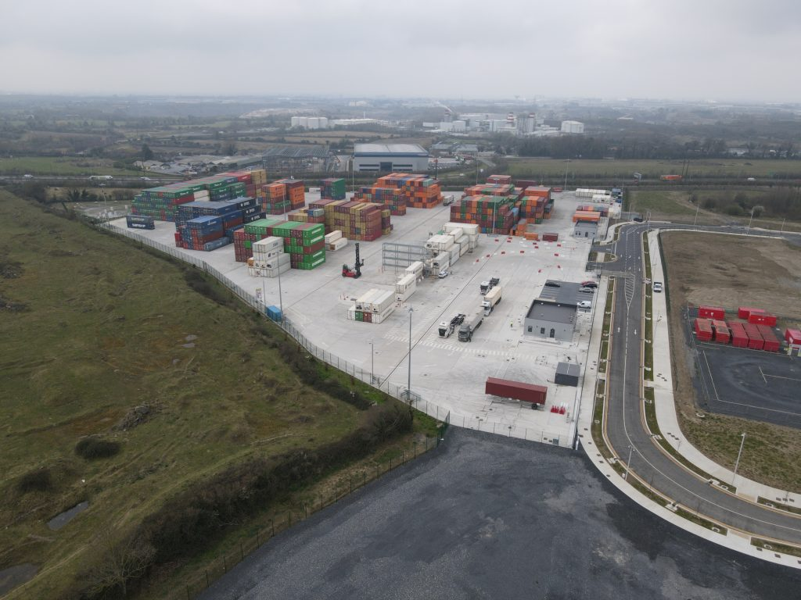
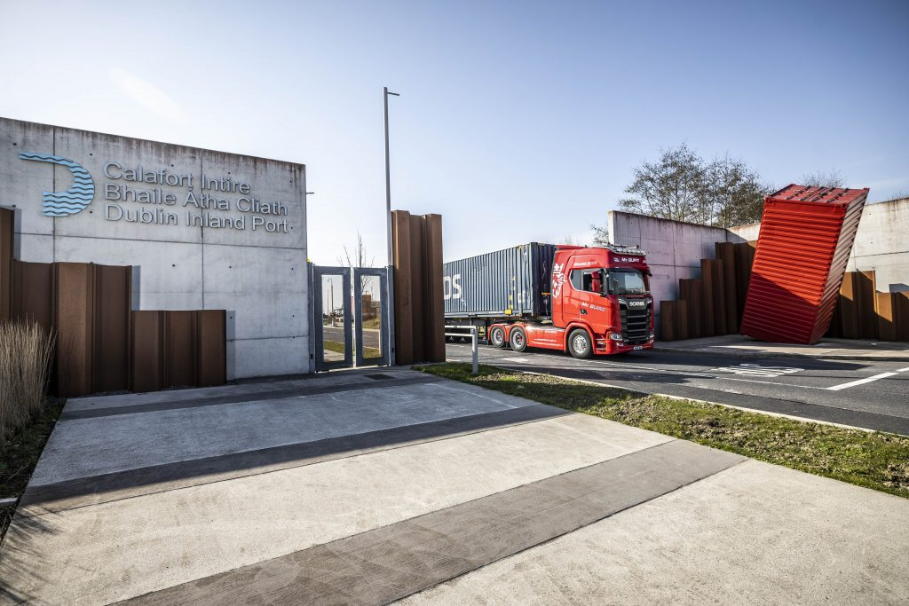
Dublin Inland Port

Slide 17
Dublin Port’s mandate is to enable international trade through the provision of berth and land capacity.
Baseline LoLo Model (Capacity enhancements as per Masterplan)
Masterplan 2040 creates Port capacity to 2040.
Running at or under capacity to end 2030s.
Base Demand High Demand Capacity under base scenario Pinch-points
1900
1700
1500
1300
1100
900
700
2025 2030 2035 2040
LoLo Capacity 000s Units
3FM Project
MP2 Project
Dublin Port handles practically all LoLo freight from mainland Europe on the East Coast. No significant alternative exists.
2045
2050
Source: Indecon Economic Consultants, September 2023

Slide 18
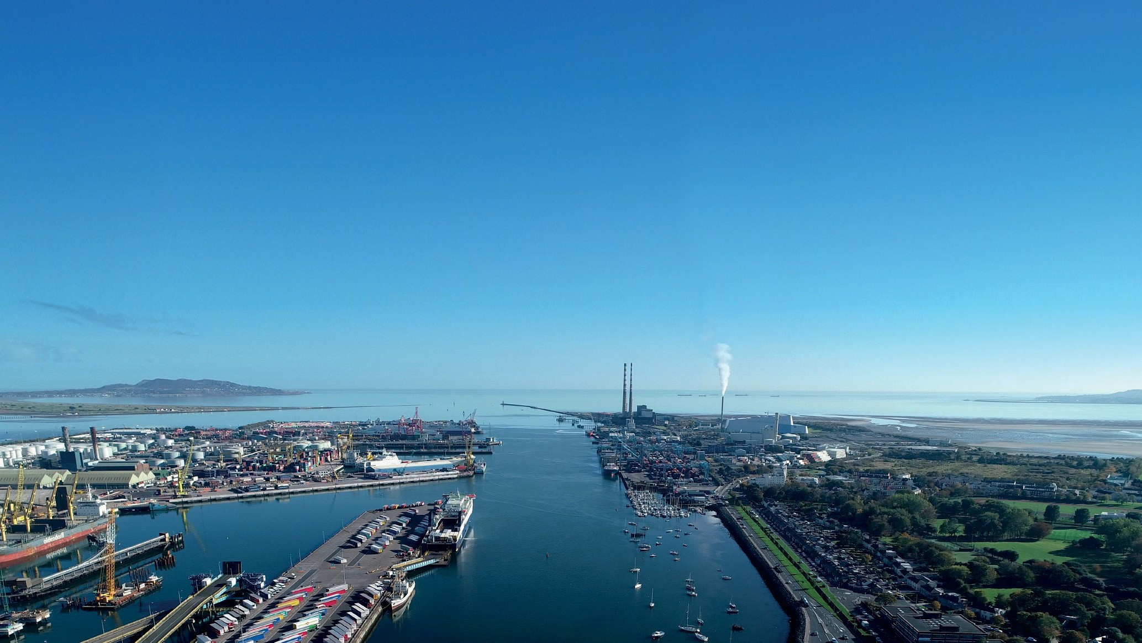
Beyond 2040
Maximising the capacity of Dublin Port while developing additional capacity on the East Coast.

Slide 19
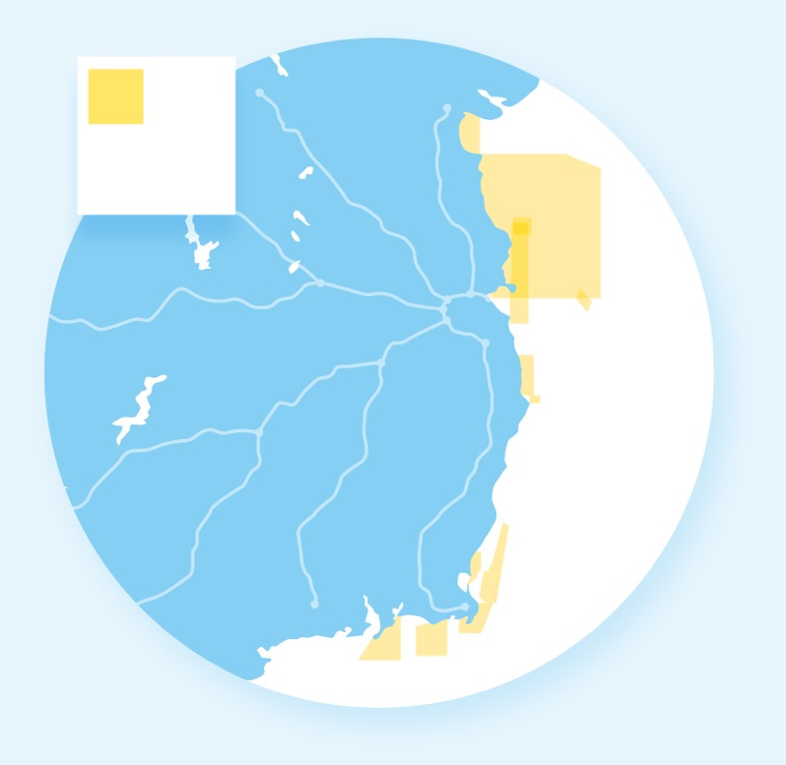
Alternatives to supplement DPC post 2040 will take 15yrs-20yrs to construct
Planning IROPI cases
a key consideration - need to prove no alternative
Rosslare
6 Natura 2000 sites
Bremore
1 Natura 2000 site
Construction
3FM – 20 years from planning to completion on existing brown field/heavy industrial site
Environmental Impact
Construction and transport
Natura 2000 sites
Any material development of port capacity on the East Coast is likely to need significant investment, involve complex planning challenges at a European level and take up to 20 years to complete during which time the State will still need to handle growing international trade.
Bremore
Dublin
Rosslare

Slide 20
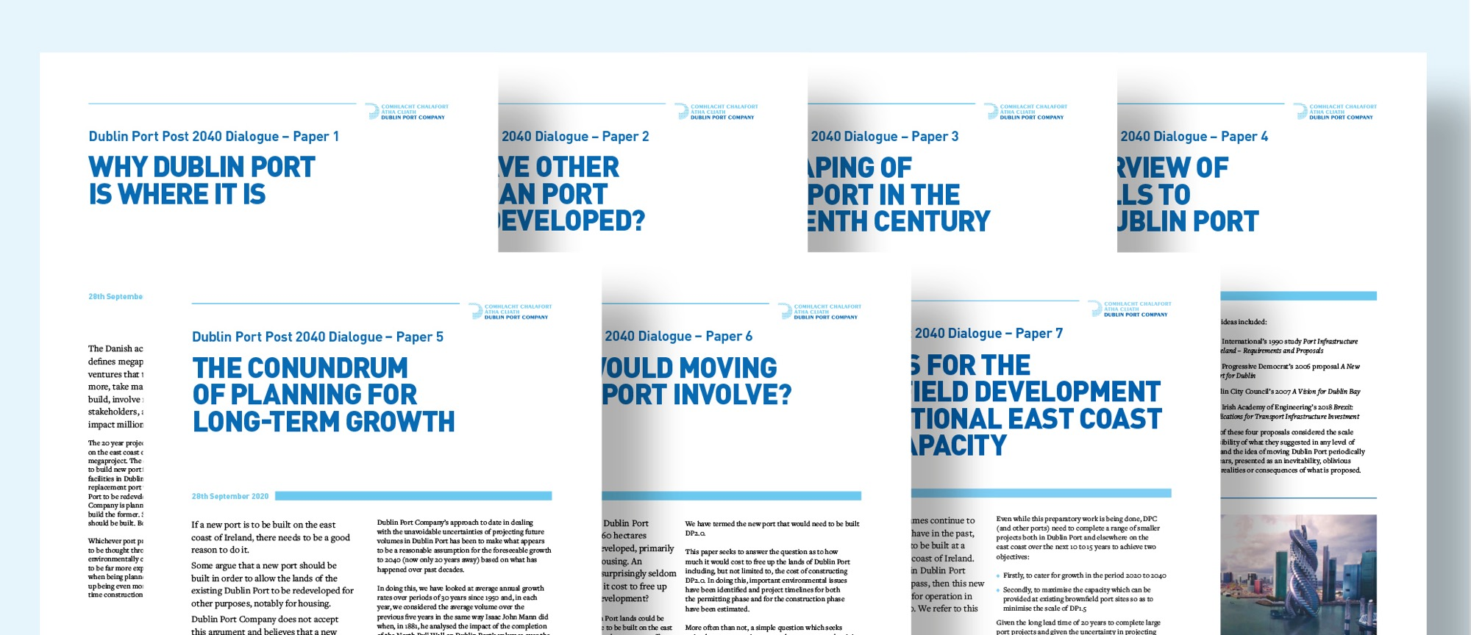
The future is to maximise Dublin Port capacity while additional port capacity is created on the East Coast.

Slide 21
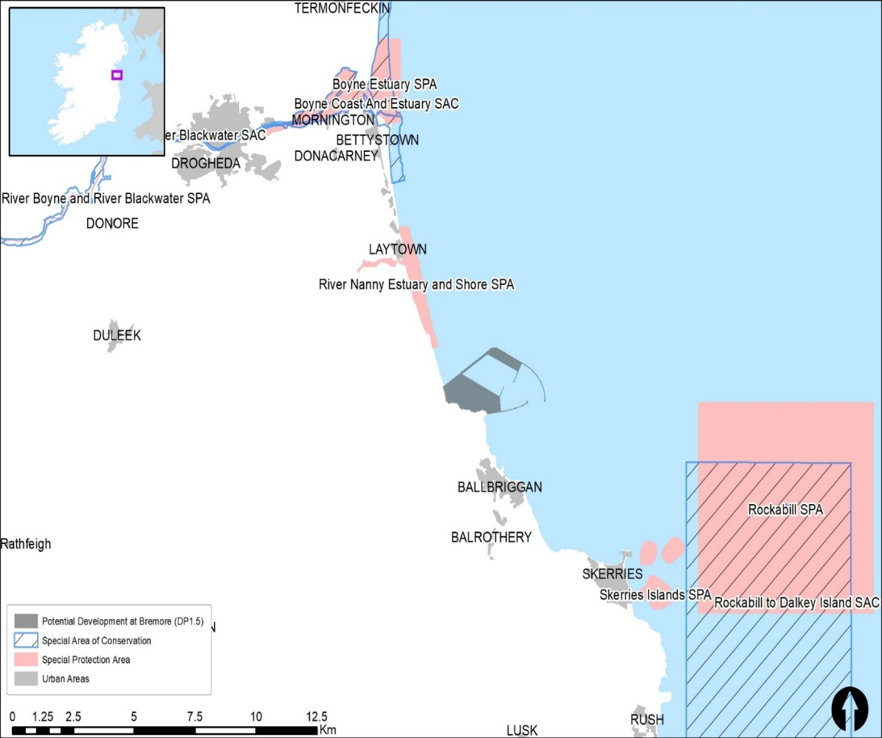
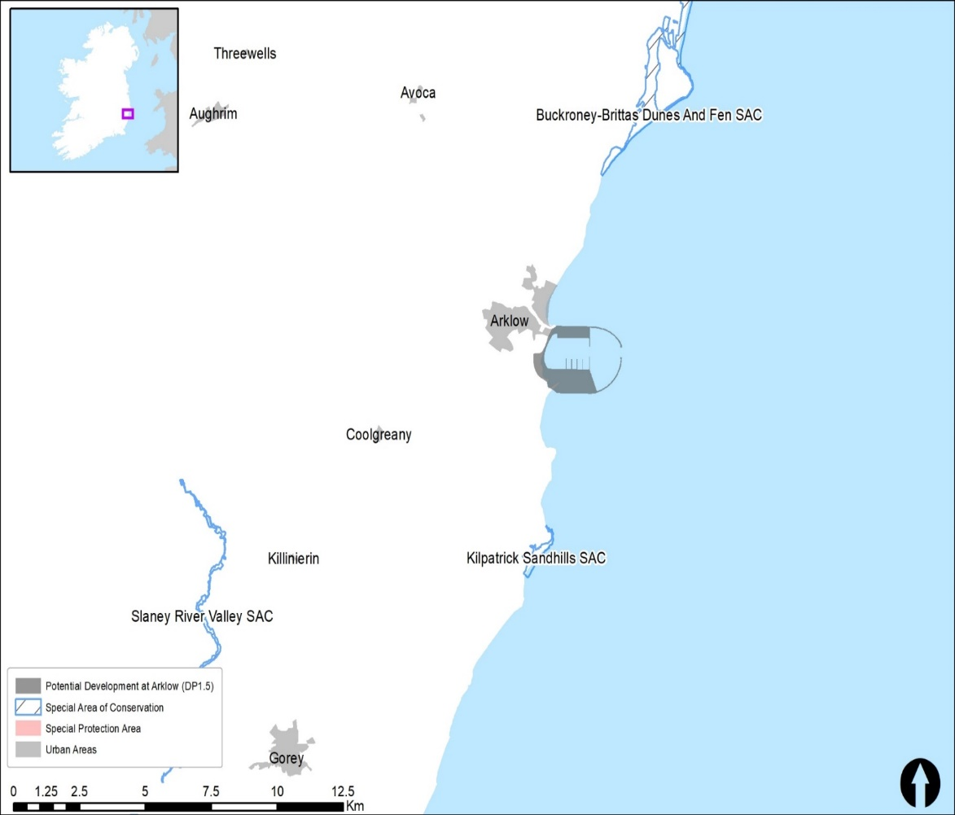
Notes:
We examined a design for Bremore where this design can accommodate xxxx tonnes and will involve the creation of breakwaters of about xxxx km
And one for arklow which can accommodate xxxx tonnes and xxxkm of breakwaters. Both clearly will have a significant impact and need to well through out and planned very carefully

Slide 22
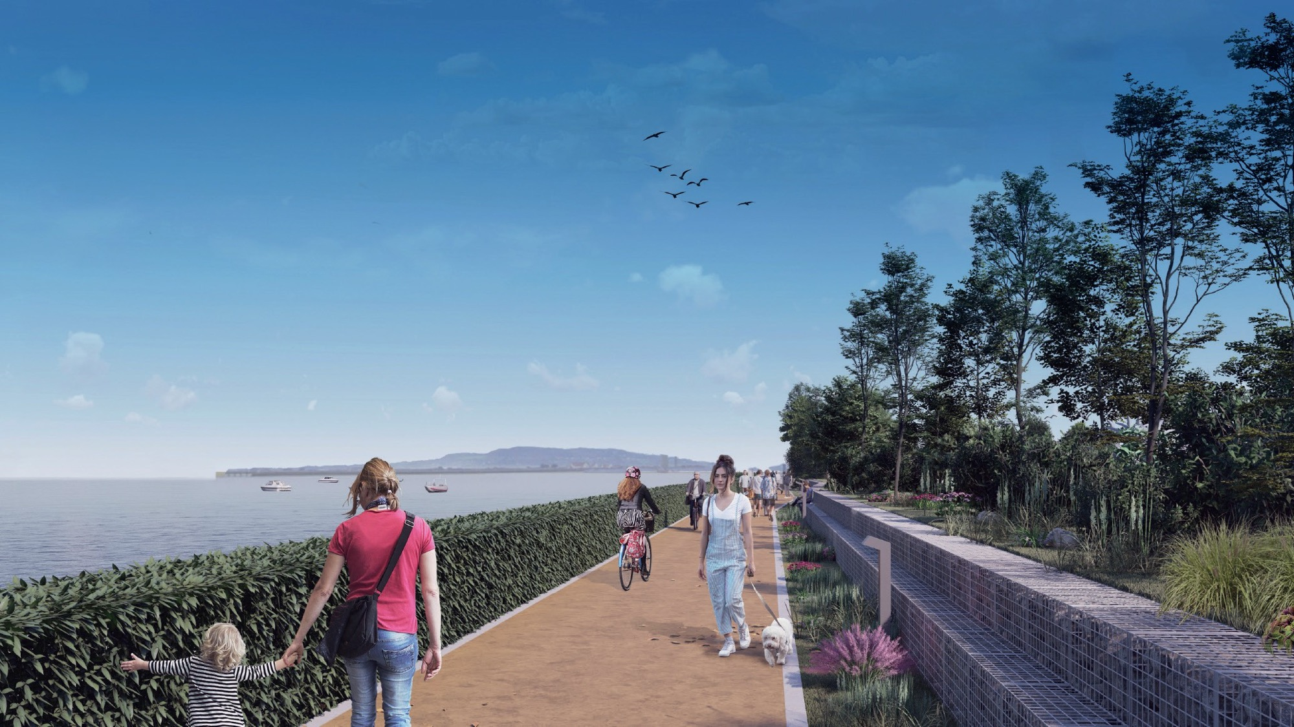
Vision 2040
Place making and Dublin Port
Making a real and meaningful difference.

Slide 23
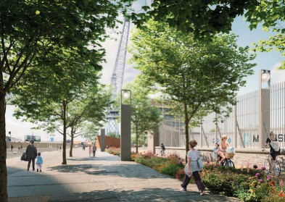
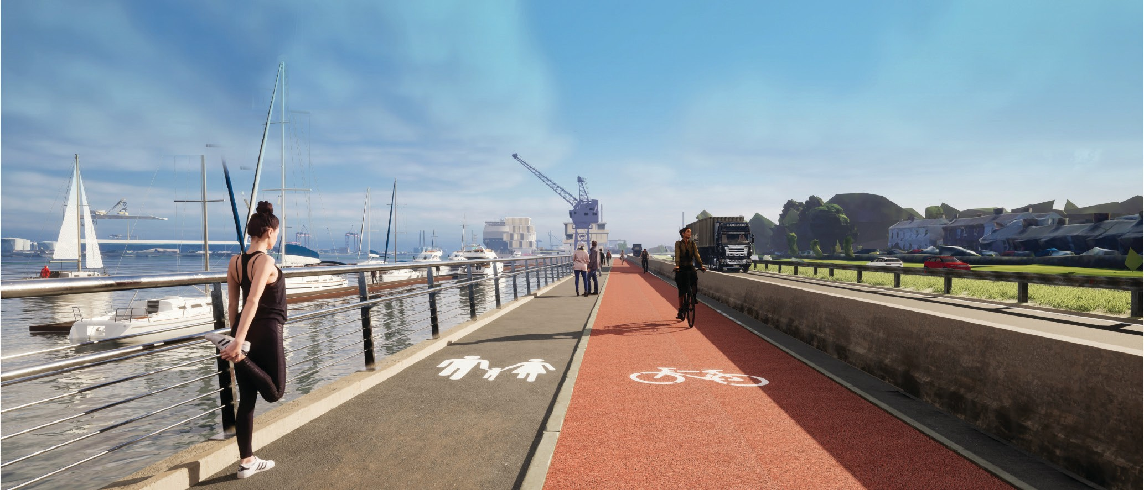
Access for all to enjoy.
Over 16km of active travel being planned throughout the Port estate
16km of active travel and greenways linking 15+ public amenities, unique heritage sites and landmarks.

Slide 24
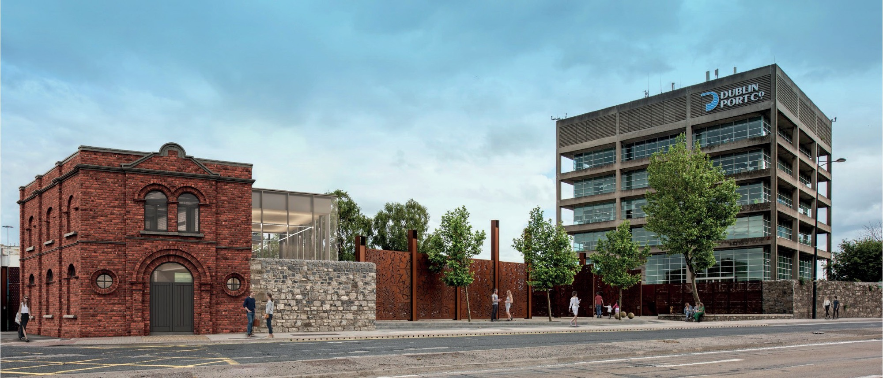
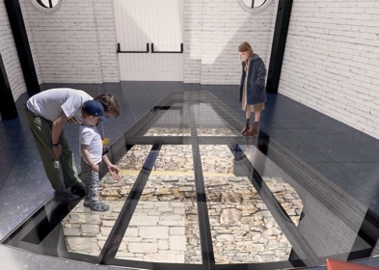
Preserving our rich heritage for future generations.
Preserving 75,000
photographs, 30,000 engineering drawings, 600 historical registers and centuries’ old heritage assets.

Slide 25
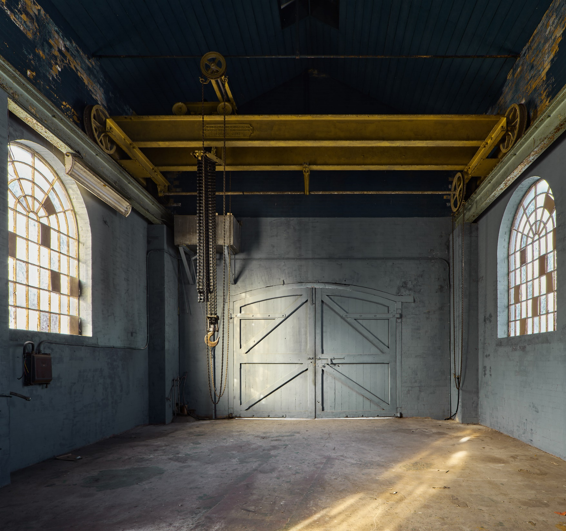
The Odlums Flour Mill and Pumphouse established as cultural destinations.

Slide 26
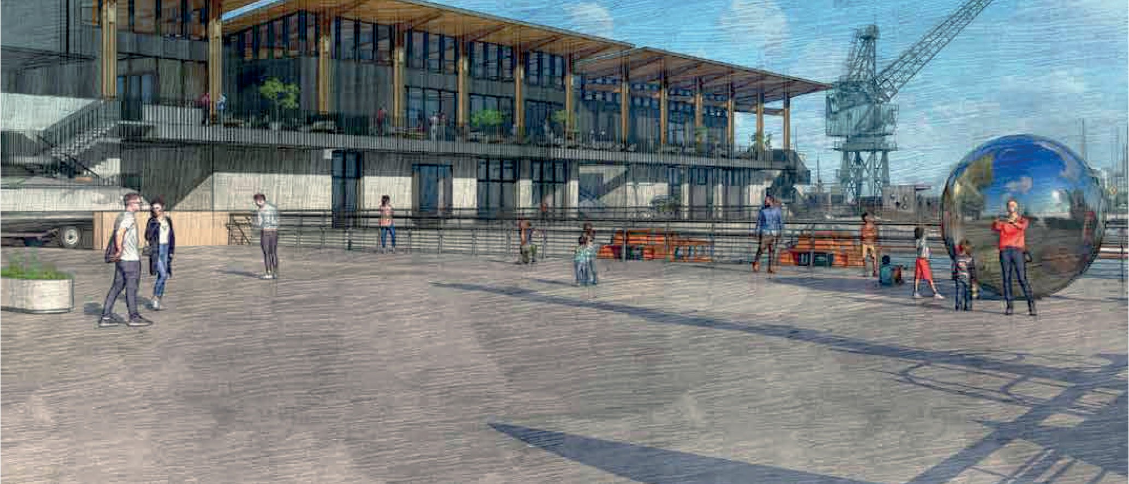
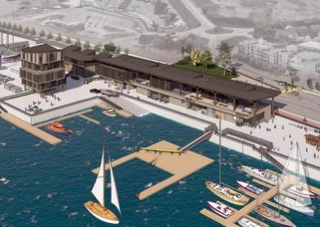
World class amenities for local and creative communities.
Waterside views and public access at a state- of-the-art Maritime Village, supporting river, boat, yacht club communities.
Significant investment & a lasting contribution to the community and the city.

Slide 27
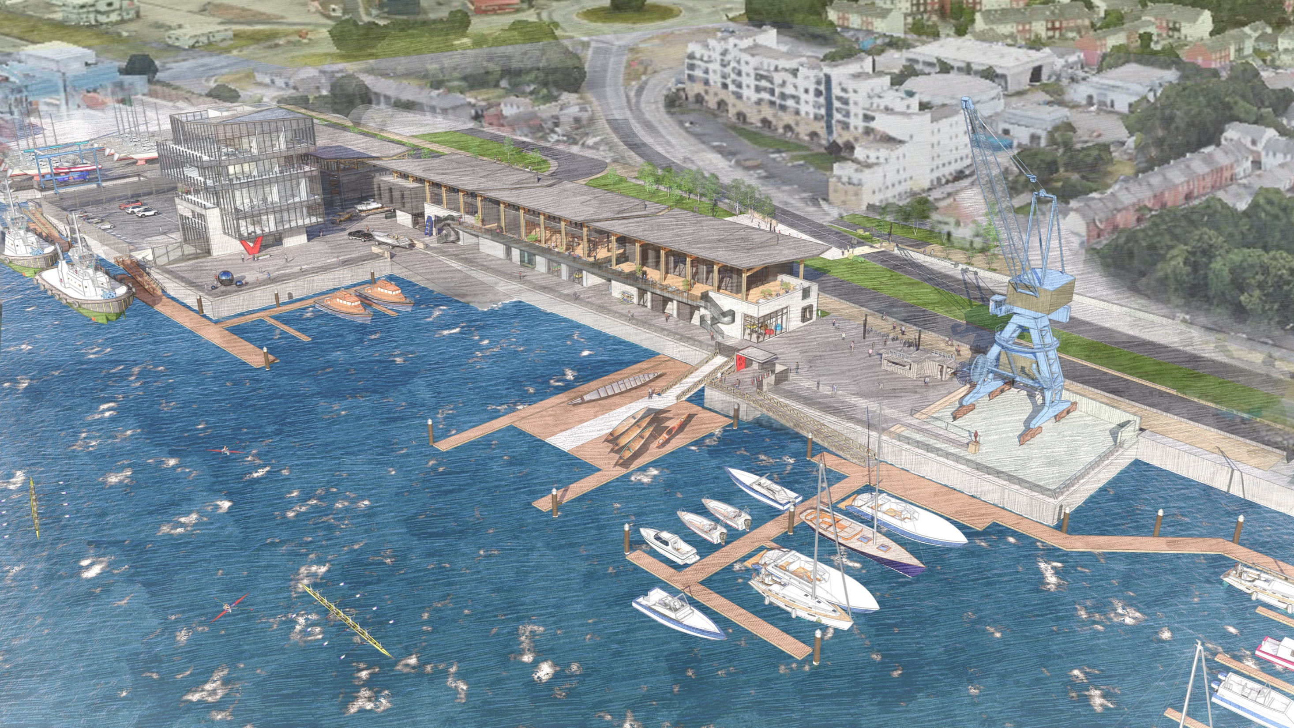

Slide 28
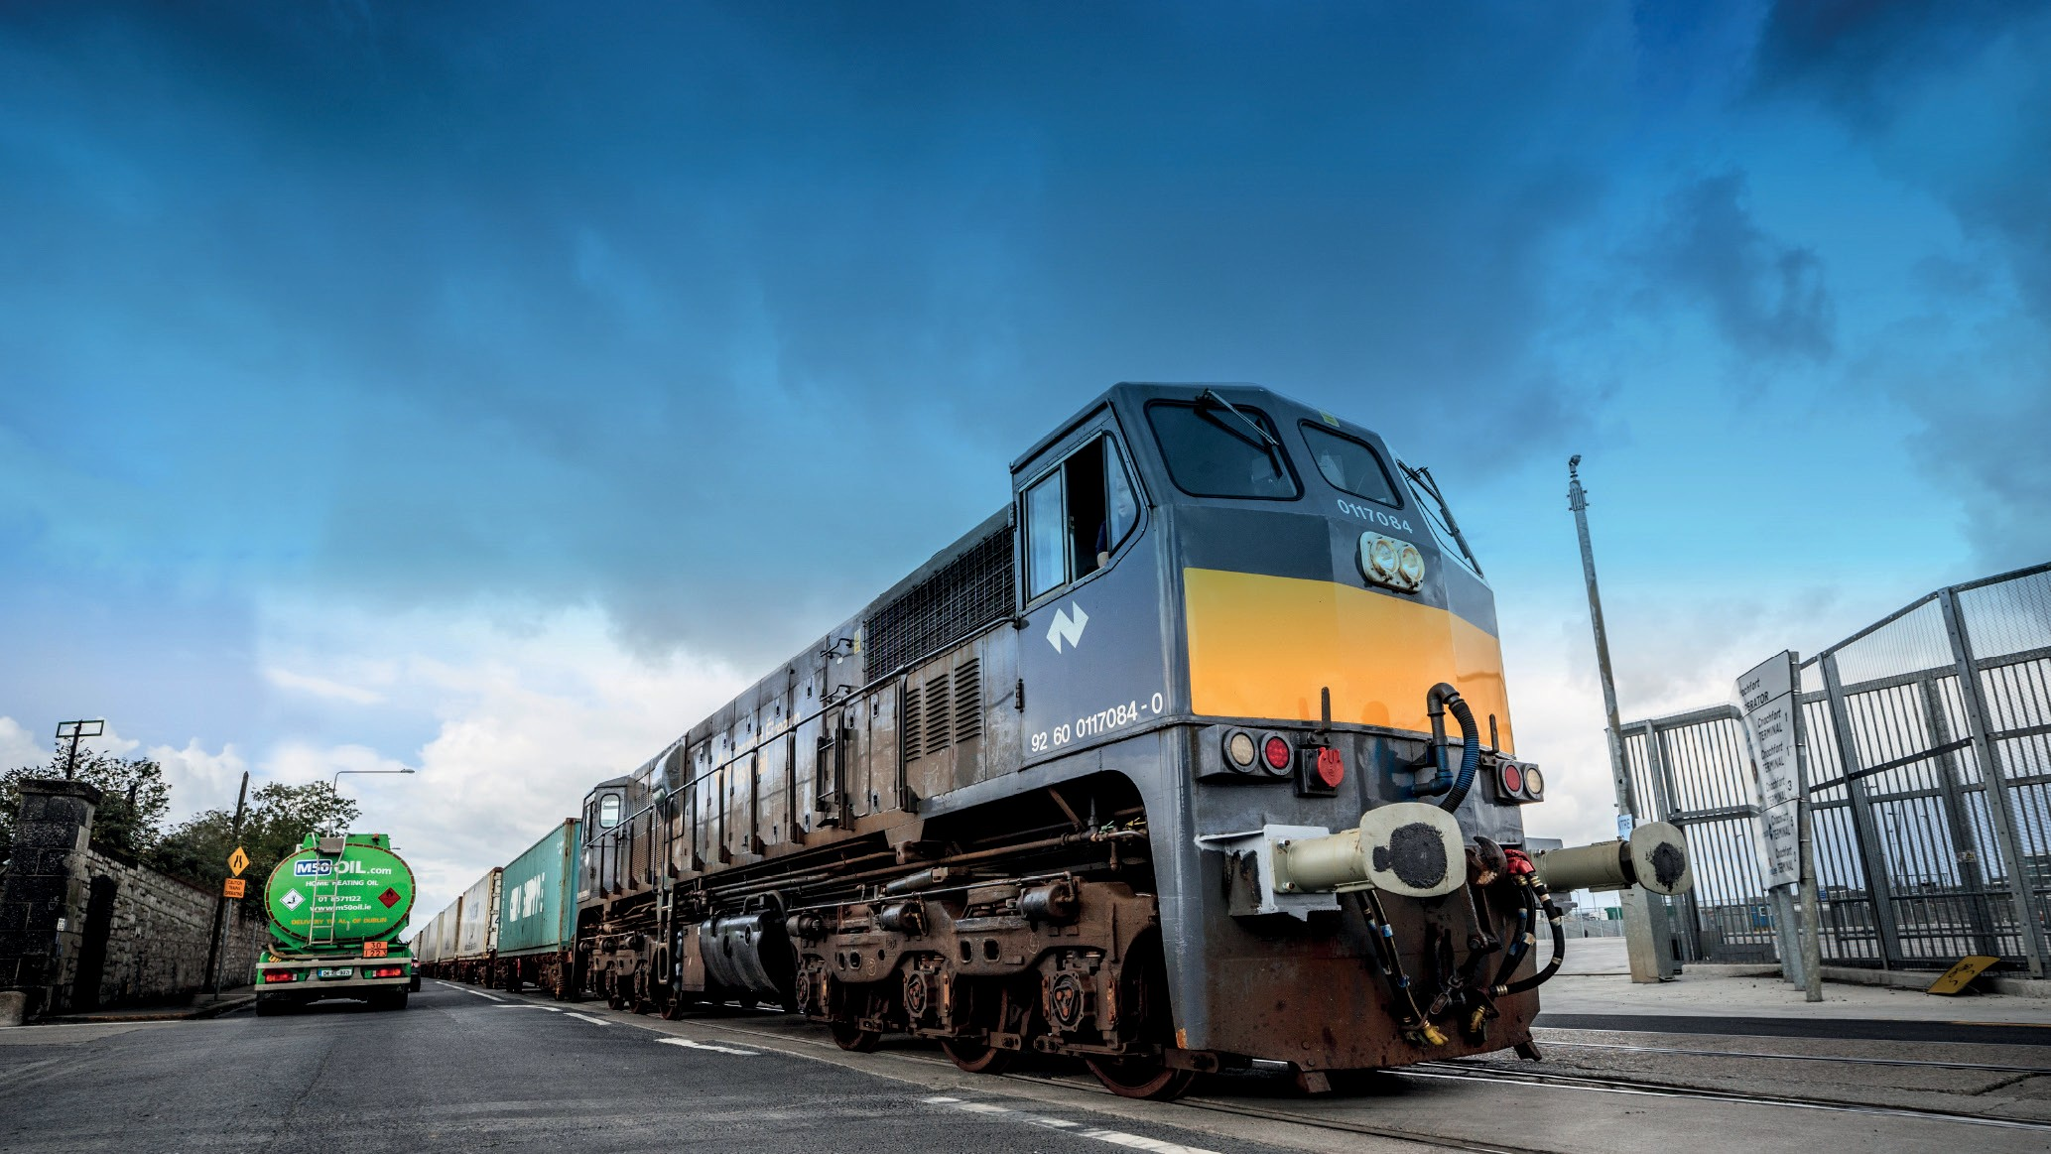
Dublin Port in the news!

Slide 29
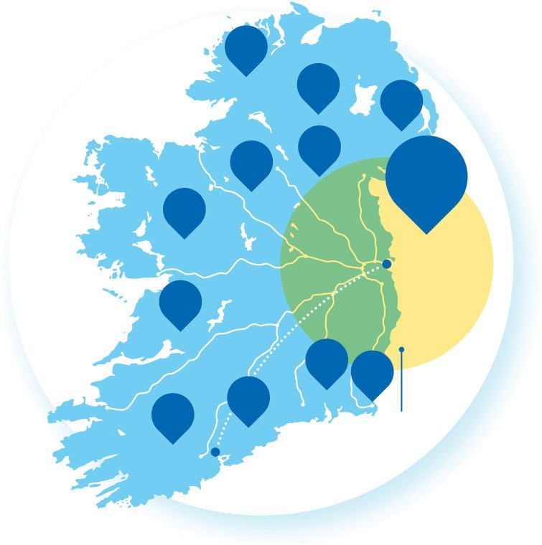
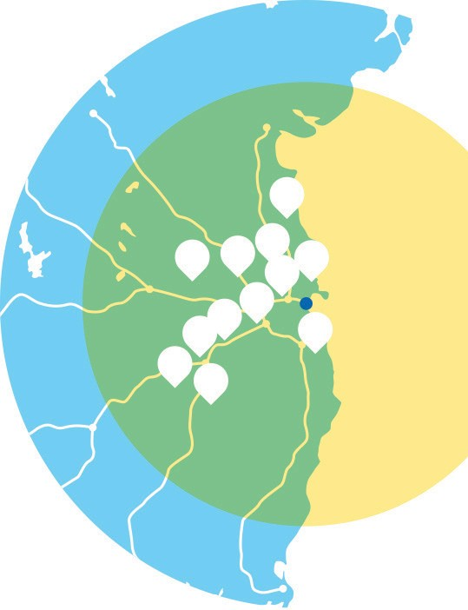
Rail Freight - Access has been in Dublin Port for many years.
Ireland’s geography and low population density pose challenges for rail freight.
Significant and consistent investment in road infrastructure
offers highly competitive alternative.
1%
3%
2%
73% of all volume to and from the Port emanates from within 90km of the Port.
1.5%
3%
73%
12
Aldi
Amazon
Dachser
Dublin Airport
DPD
Harvey Norman
Ikea
Lidl
Penneys
4
7
4%
11
6
5
The remaining 27% is widely dispersed to small centres of population around the country and only 7% is suitable for rail freight (LoLo).
Dublin
2
Dublin
1
3
10
2%
8
9
2.5%
2%
3%
90km Zone
2.5%
Power City
SuperValu
Tesco
Cork
90km Zone

Slide 30
Terminal 6 – car staging area
Car staging area
Car carrier ship 800-1000 units
Cars spend less than 2 days in staging area before being brought to car dealer
To move Terminal elsewhere would mean ships on berths for days and require revenue clearance, insurance and tax issues to be sorted out

Slide 31
Move Dublin Port
Unlikely to pass IROPI test
Many easier residential options – living over shop, better design to improve density
Climate change and rising sea levels
20 years plus to deliver
Mega project

Slide 32
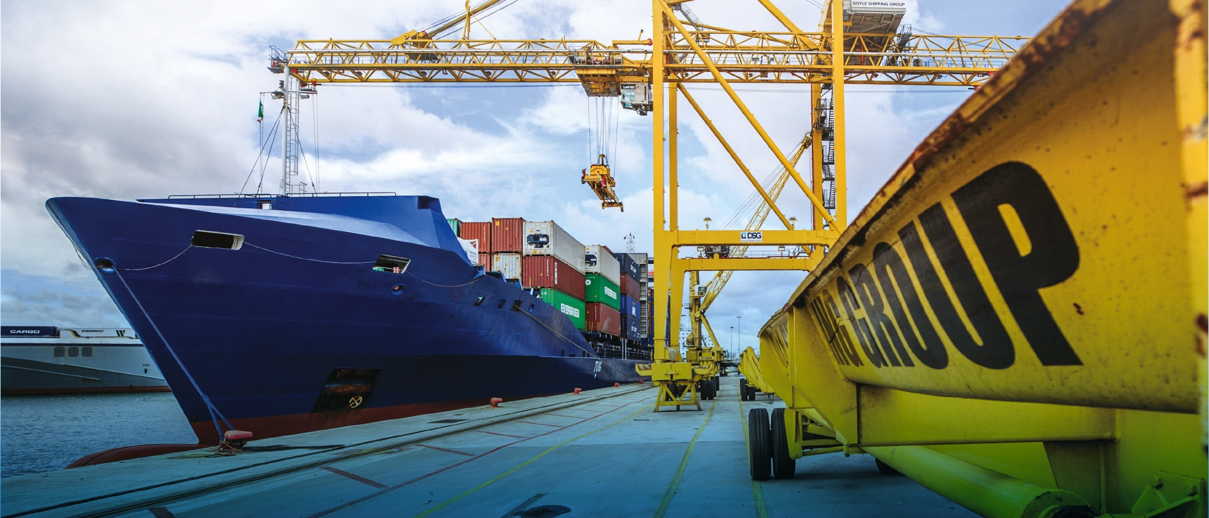
Questions

