Slide 1
Sustainability in Real Estate
February 2024
Notes:
Good afternoon and many thanks to the SCSI for arranging today sessions, and to everyone here in the room and those online for joining today. I hope this session will be of some help.
I am in CBRE 7 years, over 3 years of that now working in sustainability after completing my Masters, which focused on policy and sustainable design. I am a BREEAM In Use Assessor and so a large part of my role is working with clients on their existing assets to create strategies and pathways for improvement.
SO we’ll kick off with an overview of the competency levels expected. I’m sure you are familiar but just to recap quickly.

Slide 2
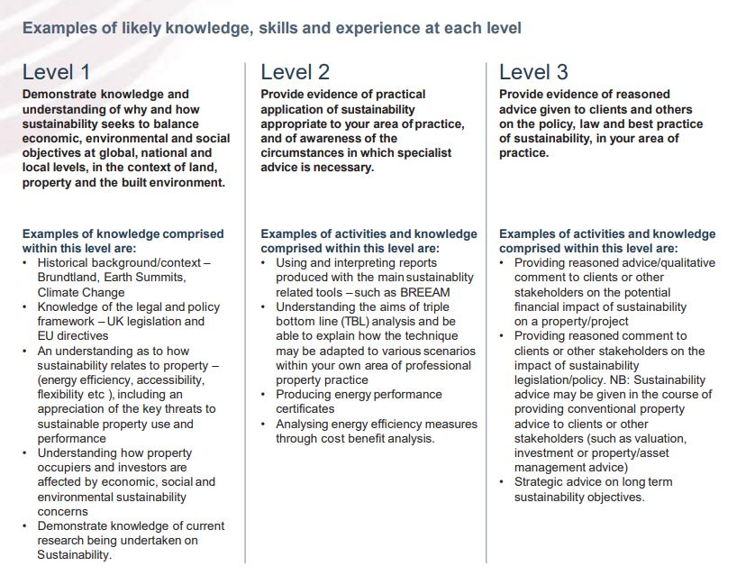
Levels of Sustainability Competency
SCSI Competencies
Notes:
Starting with an overview of the competency levels expected.
Level 1 – these are the basics, so I’d familiarise yourselves with likes of the Paris Agreement, the EU Green Deal and Irelands CAP
Sustainability at a property level – understanding this means more than just energy and carbon
Research into the impacts of sustainability on RE assets is ever evolving from impacts on values, yields and the impacts of new tech so familiarise yourself with whats best relevant to your crit/role
Level 2 – BREEAM, LEED and WELL are currently the most popular certifications used across Europe. These differ from mandatory BERs which are required by law to let or sale a building (with the exception of those exempt).
Triple Bottom Line – this is also known as People Planet Profit – The triple bottom line means to ensure that of the 3 P’s, none of these are ignored in favour of anothers. This links back really to the definition of sustainability “meeting our own needs without compromising the needs of future generations”
In the context of real estate this could mean, not developing office on greenfield sites, or building new developments while planning for the local needs, supporting local employment etc.
EPCS are Energy Performance Certificate and these are used across Europe , locally we know this as a BER – Building Energy Rating. You will need to know when they’re needed and how to advise clients on their importance. We’ll look at this in a bit more detail further on.
Cost benefit analysis will I think be a large part of all your roles. This isn’t something that just sits with the quantity surveyors or investment teams. Basic energy efficiency works, and BER upgrade plans – to a full refurbishment, requires an integrated approach from multiple disciplines to ensure that capital spent can either reduce operational costs, be claimed back through taxes , improve rents or yields etc.
Level 3 – I’m not sure if many of you are hoping to include sustainability at level 3 competency, but if so, reach out to me afterwards if you have specific queries that we don’t get time to address today.
At this point though you would likely be expected to deliver advise around deliver much of the previously mentioned works.

Slide 3
Most Critical Impact Areas in Real Estate
Introduction
Environment
Social
Governance
Site Risks
Energy Efficiency
Net-Zero Carbon
Water
Waste, Resources and Circularity
Biodiversity and Land Use
Health & Safety
Wellbeing
Mobility & Transport
Amenities & Services
Social Value
ESG Strategy and Targets
Reporting
Standards, Labels and Certifications
Stakeholder Engagement
Physical Climate Risks
Transitional Risks
Notes:
A quick overview of What does ESG mean and how is it relevant in the context of real estate.
E – often mistaken here for Energy may be the most obvious and familiar to you.
S:
Covers standard health and safety as well as Wellbeing. This has amplified in demand post covid to provide comfortable workspaces that are enticing for occupants
Mobility and transport and amenities are important areas that support sustainability in the work space through providing people the means to be able to travel to work in healthy and sustainable methods
Social value – what does the asset, development, portfolio provide to the locality – that it actually needs. This often requires a lot of early stage stakeholder engagement
G - Typically this would have been the annual CSR reports, however this is now the driver for implementing sustainability through mandatory and stringent reporting

Slide 4
Legislation
Legislation & Compliance
EU Taxonomy
CSRD
EPBD
The EU Taxonomy is a classification system that defines criteria for economic activities that are aligned with a net zero trajectory by 2050 and the broader environmental goals other than climate.
For acquisition and ownership of buildings, criteria includes requirements for a BER of A, or be in the top 15% of the national or regional building stock expressed as operational Primary Energy Demand.
In addition, the asset must have a compliant Climate Risk and Vulnerability Assessment and demonstrate efficiently operations through energy performance monitoring and assessment
The Corporate Sustainability Reporting Directive is aimed at improving the consistency and quality of ESG reporting by companies, requires majority of larger companies in the EU to report on their performance.
This directive will require all large organisations in Ireland to set targets for and report on ESG metrics. It is expected that this will drive demand for sustainable workplaces.
Tenant requirements for energy data and green leases may increase, so that they can comply with CSRD reporting.
The Energy Performance of Buildings Directive requires all European Union member states to establish minimum energy performance requirement for buildings.
This also ensures that all new buildings are nearly zero-energy by 2050. The directive requires from 2025, EU countries stop subsidising “standalone” fossil heating systems, and the phasing out of fossil fuel boilers by 2040.
Health & Safety
Wellbeing
Mobility & Transport
Amenities & Services
Social Value
Paris Agreement Legally binding agreement
EU Green Deal
Irish Climate Action Plan
Notes:
SO starting why our WHY – Why are we looking at sustainability in RE?
Legislation Recap
Paris Agreement, is a legally binding international treaty on climate change adopted at COP21 where a framework towards net zero for 2050 was agreed and a pledge to prevent global temperatures rising by more than 1.5C. trajectory
Following Paris Agreement - the EU Green Deal is the EU's strategy, which outlines a set of policy initiatives by the European Commission with the aim of making the European Union climate neutral in 2050.
Ireland’s Climate Action Plan sets a roadmap to halve Ireland's emissions by 2030 and reach net zero by no later than 2050
The CAP Annex of Actions provides more detail on the actions required to achieve the targets set out in the Plan
Other legalisation items of importance
The EU taxonomy for sustainable activities is a classification system established to clarify which economic activities are environmentally sustainable, in the context of the European Green Deal.
At this point in time, top 15% of PED for office buildings is approximately equivalent to a BER of B3*
*this must be clarified with the SEAI.
CSRD – This directive, in effect since 5 January 2023, that requires EU businesses to report on the environmental and social impact of their business activities, and on the business impact of their environmental, social and governance initiatives
The Energy Performance of Buildings Directive is the European Union's main legislative instrument aiming to promote the improvement of the energy performance of buildings within the European Union.

Slide 5
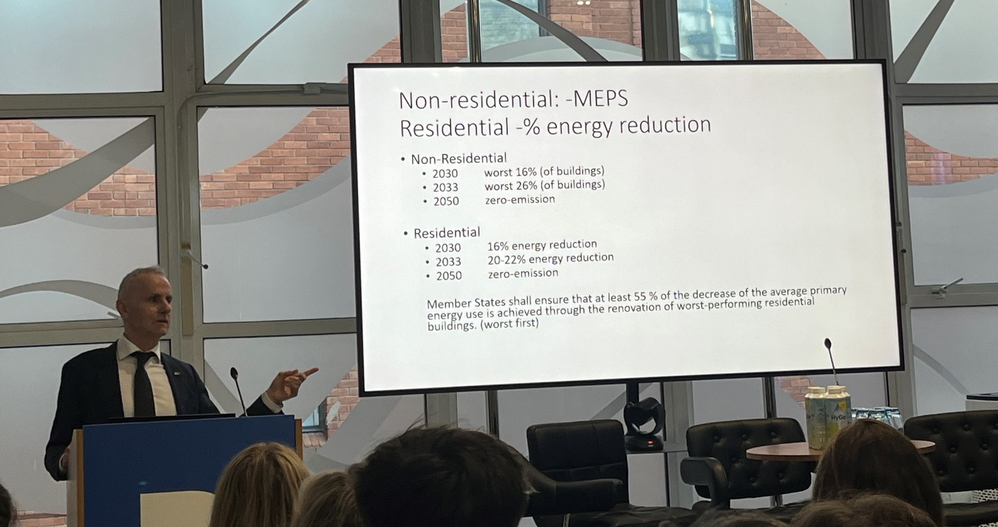
MEPS
Minimum Energy Performance Standards
Notes:
In 2023 the European Parliament accepted the European Commission's proposed revisions to the 2018 Directive This is a photo from a recent event with MEP, Ciaran Cuffe who was the Irish representative on the EPBD recast.
If you can’t see, this outlines the requirement to target the worst 16% of commercial assets by 2030, and worst 26% by 2033, before reaching net zero in 2050.

Slide 6
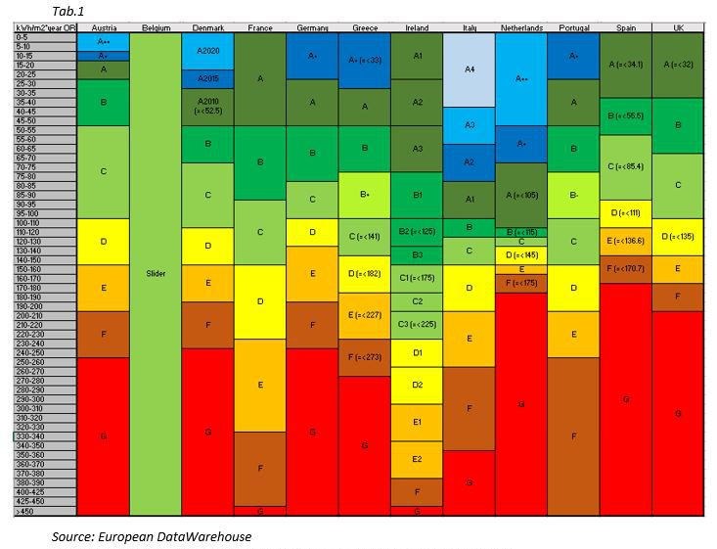
EPC/BER
Minimum Energy Performance Standards
A Building Energy Rating (BER) or Energy Performance Certificate rates a buildings energy performance on a scale between A and G. A-rated being most energy efficient while G-rated are the least energy efficient.
An analysis was carried out to compare different energy performance certificate (EPC) ratings and methodologies across residential Europe.
Notes:
The only method for currently measuring this are EPC across Europe/ or locally BERs,
A Building Energy Rating (BER) or Energy Performance Certificate rates a buildings energy performance on a scale between A and G. A-rated being most energy efficient while G-rated are the least energy efficient.
So, at a European level it was proposed to set Min Energy Perf St across EU. And I think this slide clearly states why this is needed. Now this is using data for residential dwellings across Europe, but same logic applies. If an investor is trying to benchmark and plan improvements for a portfolio across Europe, this can prove difficult. Hence the harmonization of EPC, while no mean feat, will help us improve standards.
So if we look at Ireland A3 BER threshold, that is equal to only a B or C in Denmark. Italy for example has much wider thresholds for its EPC ranges.
Its worth noting that Irish specific targets are yet to be set for our MEPS. For now we are just following EU min requirements

Slide 7
Where are emissions hiding?
Emissions
Global CO₂ Emissions by sector
6%
Operational Carbon
Other
27%
23%
Building operations
Transport
Embodied Carbon
10%
Building construction
33%
Source: IEA 2021a, Global Alliance for Buildings and Construction. 2021 Global Status Report.
Indirect emissions are emissions from power generation for electricity and commercial heat.
Other industry
Notes:
As i’m sure most of you know, 37% of emissions come from the built environment.
However, only 10% of these emissions come from building the structure and materials itself,
With the remaining emissions coming from the building operations across its life cycle.
This is why its so important post Green building certification, to maintain optimal levels of efficiency so that after achieve LEED Platnum, BREEAM Outstanding or whatever the case may be, that the building continues to perform as expected
In existing buildings over 15, 20 years typically BER improvements, which can include MEP upgrades, control systems upgrades to BMS, lighting etc are needed, to improve the level of efficiency

Slide 8
The big picture: Net zero carbon
Net zero carbon asset planning
2050
EU and IE deadline for net zero carbon
80%
of building stock that will exist in 2050 is already built and needs retrofitting
51%
Irish Government Commitment to reduction in carbon emissions by 2030
37%
of global carbon emissions can be attributed to the built environment

Slide 9
Decarbonization roadmap
Nzc
Not all avoided carbon is created equal
Start with a plan
Use less energy
Electrification
Influence supply chain and impact on Scope 3
Make green energy locally
Create ‘over the horizon’ green energy
Creditably offset the carbon balance
Client decision support
Inventory creation, goal setting, process development, cost forecasting, reduction strategies aligned with Science Based Targets (SBTi)
Leverage an asset based retrofit strategy via APEX7 to increase efficiency
Efficiency retrofits
Scale rapidly with Efficiency-as-a-Service
Replacement of fossil fuel burning equipment with efficient electric
Heat pumps including chillers and ground source
Thermal storage
Outsourcing responsibly
Support holistic corporate sustainability strategies
Water conservation
Waste reduction
Commercial and industrial solar
Car canopy solar
Solar thermal
Electric vehicle charging
Onsite biomass and biogas
Virtual power purchase agreements (vPPAs)
Offsite PPA
Carbon offsets
Renewable energy certificates (RECs)
Carbon sequestration
Other emerging technologies
MONITOR AND REPORT
Notes:
What does decarbonising mean? How to we achieve NZC?
80% of buildings that will be occupied in 2050 already exist, meaning decarbonising existing stock is a major priority.
So here are some simple steps when thinking of how to decarbonise: Set targets and make a plan to achieve them
Look at optimising effiency through BMS controls, smart systems,
Removing fossil fuels
Using resp suppliers to reduce Scope 3 emssions
Generate clen energy on site
Look at PPA or VPPA - a financial arrangement between a developer and the buyer which guarantees a cash flow for the renewable energy project based on output.
And last step is always to credible offset through sequestration projects

Slide 10
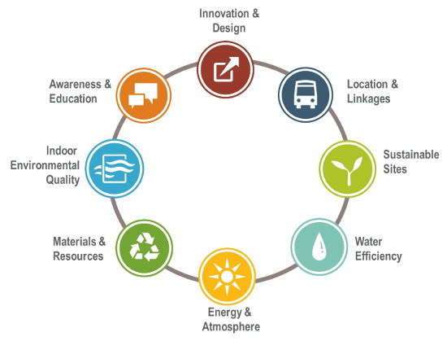
Which standard for the Real Estate industry ? LEED
GREEN BUILDING CERTIFICATION
The LEED approach is an environmental certification originating in America and recognized around the world,. Its LEED O+M version applies to all types of buildings in operation.
LEED is a voluntary standard, acknowledged at international level that defines high performance green buildings and interiors, which are healthier, more environmentally responsible, with more cost-efficient structures and more productive staff.
Assuming all prerequisites are met, depending on the number of credits achieved and the points awarded following the assessment of the Green Building Certification Institute (GBCI), that is the responsible body for assessing the certification applications, the premises will receive one of the following certifications:
LEED stands for
Leadership in Energy and Environmental Design
Certificate example
Notes:
So for level 2 you’ll need to be comfortable understanding green builing certs
LEED is a green building certification you’re likely aware of.
This is a US framework and so some elements, such as requirements for energy credits, require conversions to local standards
Overall this is very popular with FDI clients and big tech clients.
It provides assessment across a range of environmental sustainability issues, and can be applied to buildings and fit outs, in design, construction and operations. And across multiple asset classes which a range of ratings from certified to platinum

Slide 11
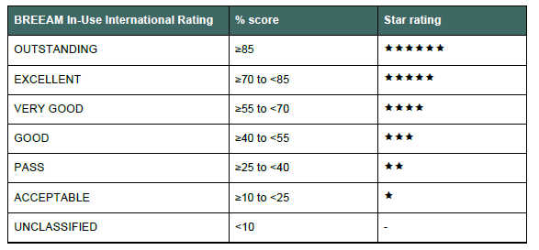
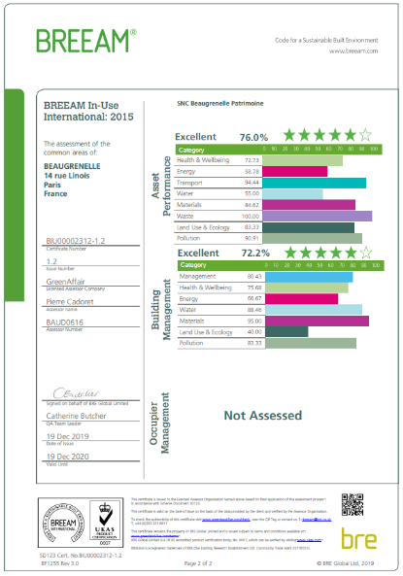
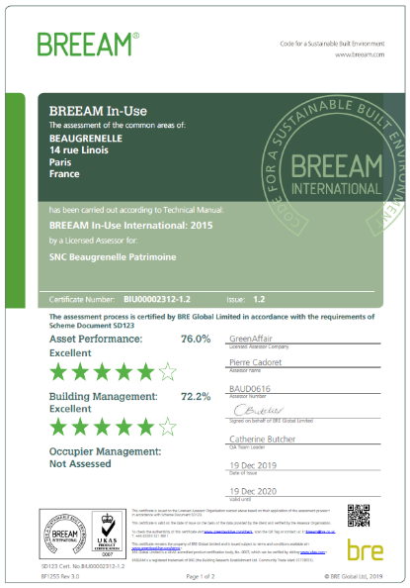
Which standard for the Real Estate industry ? BREEAM
GREEN BUILDING CERTIFICATION
The BREEAM approach is an environmental certification originating in the United Kingdom and recognized around the world, particularly in Europe.
The BREEAM In-Use certification is an effective support for structuring the management of a building, for having its environmental qualities recognized or for piloting an environmental strategy at the level of real estate portfolios.
Different performance levels, from "ACCEPTABLE" to "OUTSTANDING" can be achieved, depending on the intrinsic characteristics of the buildings, their date of construction / renovation and depending on the performance of the management of its operations.
BREEAM stands for
Building Research Establishment Environmental Assessment Method
Management | Transport | Health & Wellbeing | Energy | Water
Ressources | Pollution | Resilience | Land Use & Ecology
Certificate example
Notes:
BREEAM was developed by the Building Research Establishment in the UK, and is widely used in the UK and Europe.
This framework is an environmental rating tool for buildings and interiors.
However, when it comes to certifying that previously mentioned 80% of existing building stock before 2050, BREEAM In Use is arguably more flexible than LEED as it is specifically designed for operational assets.
BREEAM being a UK framework, it aligns more so than LEED with the Irish Building Regs in the energy category so can be a bit easier to apply and well recognised and understood across EU

Slide 12
Measuring sustainability – Performance
BIU Due diligence
Sustainability Assessment Summary
BREEAM In Use Part 1 Pre-assessment Results
A gap analysis of the building by a Sustainability Consultant according to BREEAM In-Use International (min. Part 1) in order to high-level confirm:
The current BIU score and level
Improvements necessary to reach the next level i.e. “Pass/ Acceptable/ Good/ Very Good/ Excellent”
 | Site visit |  | Potential rating based on 1 level improvement
 | Credits achieved | Category score | Credits achieved | Category score
Health and Wellbeing
Energy
Transport
Water
Resources
Resilience
Land Use & Ecology
Pollution
Exemplary (additional)
Total BIU score (%)
BIU Level
BREEAM In-Use pre-assessment chart
Notes:
So how do you evaluate or measure performance using green building certification. Lets looks at this BIU gap analysis.
Typically this requires a review of all available data – which existing assets this can be very limited. Then we’d undertake a site walk inspection to see how we can observe.
The graph here shows how we can benchmark an asset based on what’s currently in place versus what can realistically be implemented to improve performance.
Personally, I always try align any pre assessment for BIU with a BER improvement pathway as tere are often many synergies for the energy credits. The arguably other areas such as health & wellbeing and transport – these might require upgrades or installing showers, dry rooms and locker, bike racks, EV charging points etc – these while they are deemed sustainable criteria, are also pretty basic market requirements.

Slide 13
The WELL Building Standard
GREEN BUILDING CERTIFICATION
Air
Water
Nourishment
Light
Movement
Thermal Comfort
Sound
Materials
Mind
Community
Key Facts
Launched by the International WELL Building Institute (IWBI) in 2014.
A leading tool for quantifying health and well-being features of built environment.
Includes people-centric guidance.
Vetted through a comprehensive, expert peer review process.
Found on five principles: Equitable, Global, Evidence-based, Technical Robust, Customer focused, and Resilient
Evidence-Based
Verifiable
Implementable
Incorporates the latest science and public health research.
Third party verified and on-site tested by a WELL Testing Agent.
Rigorous tests, data-driven and adopted by global markets.
Notes:
WELL is a science based certification that looks at optimising wellness for occupants.
Launched by the International WELL Building Institute (IWBI) in 2014.
A leading tool for quantifying health and well-being features of built environment.
Includes people-centric guidance.
Two types of project: Owner Occupied - Project is mainly occupied by project owner i.e. fully fitted out spaces.
or WELL Core- Project owner occupies less than 25% of project area and rents/leases more than 75%.
Non-leased areas include common areas and private spaces directly under control of management team.

Slide 14
Green Leases How does a Green Lease Review work?
Stakeholder engagement
1. Portfolio review
Does the site meet basic requirements for a green lease to be signed ?
Does the site have a potential to satisfy additional Green Lease requirements ?
2. Green Lease clause proposal
Which Green Lease clauses should be proposed to the landlord ?
Do landlord’s Green Lease clauses meet client’s requirements ?
3. Red Flag review
Are there any clauses proposed by the landlord or rejected by the landlord that would prevent client from signing the lease ?
Are there any clauses that should trigger rent renegotiations ?
4. Final Green Lease rating
Which Green Lease clauses are to be implemented and how do they relate to client’s Sustainability ambition ?
Notes:
Simplified a Green Lease is a commercial lease, containing additional clauses that the building must be occupied, operated and managed in an environmentally sustainable manner. There are Light, medium and dark green leases, depending on LL and tenant sustainability criteria.
They should enable better data sharing, better collaboration on improvements such as obtaining and maintaining green building certification, energy efficiency measures, waste reduction and management, recycling and using sustainable materials for repairs and alterations.
This will really be bepoke to each instruction.
The Chancery Lane website is a resource that provide a glossary of legal jargon and outlines examples of clauses
Its the largest global network of lawyers and business leaders using the power of climate contracting to deliver fast and fair decarbonisation.

Slide 15
Project Stages
ESG Consultancy across Project Stages
Strategic direction
ESG Strategy, Engagement & Disclosure
Across different disciplines
Asset level solution
Asset acquisition
Planning support
Construction, refurb & fit out
Operation & maintenance
Demolition or sale
Environmental Impact Assessment
Flood & Climate Risk Analysis
Sustainability Benchmarking
Environmental, Socioeconomic and Health Impact Assessments
Sustainability & Energy Statements
Lifecycle Assessments
Flood Risk and Contamination Assessment
Sustainability feasibility
Sustainability Certification(s)
Wellness Certification
Close the Performance Gap
Data Management
Environmental Compliance
Stakeholder Engagement
Energy Audit
IT (Smart building tech)
Sales/Vendor Pack
Recycle and Reuse
Sustainability
Notes:
I quickly put together this slide in the aim of highlighting how there are multiple stages in the cycle of any asset that require your sustainability knowledge.
Acquisition –a data room can tell a lot about an asset, what documents are, or aren’t available. What’s the BER? Is there a EIAR? Flood Risk? Climate RISK? CREEM? Any pathways for improvement? If so do the have a cost analysis?
Planning – This will require outside the norm reqs, consideration for socioeconomic assessments to determine if there can be any social value add. Life cycle analysis and stakeholder engagement are really important here too
Construct/refurb – this is your Feasibility studies, certification pathways, implementing sustainability as standard practice, or carrying out any upgrade works deemed required. It is always cheaper to incorporate sustainable feature at design, not think of it as a bolt on at the end
O&M – the operational stages of assets are the most carbon intensive as we discussed, so its important that there is good data management, good BMS and controls, green leases clauses to support data sharing and engagement
Demolition/sale – its becoming increasingly difficult to demolish anything in Dublin CC without a very strong case for how demolition is actually the most efficient pathway – this is usually where the building design does not allow to compliant refurb or adaptation.

Slide 16
Thank you
Jamie Cole
Sustainability Consultant
Jamie.B.Cole@cbre.com

