Slide 1
CPD Requirements – Building Control Act, 2007 (BCA)
February 2024
Gwen Wilson – Registrar

Slide 2
CPD Requirements - BCA
Relevant resources:
Building Control Act, 2007.
Regulation of Providers of Building Works and Miscellaneous Act 2022.
Continuing Professional Development and Your Registration under the Building Control Act 2007 (As amended) – Guidelines for Registrants on the statutory system of CPD.
CPD online portal.
Contact registration@scsi.ie

Slide 3
CPD
Continuing Professional Development in the Built Environment plays a significant role in your career as a construction professional.
Modern CPD refers to the identification of a skills/experience or knowledge gap in one’s profession, recording the training activity after the event and reflecting on its application.
An activity log is kept and continually updated as required.
CPD is a process and will continue throughout one’s career and supports lifelong learning.

Slide 4
Key steps to CPD compliance
Identify the gap in your knowledge, skills, or experience.
Find and attend a course or activity that will fill the gap.
Record the event.
Apply the knowledge, skills, or experience gained.
Reflect on the learning and development.
Repeat.

Slide 5
Apply what you've learned
A building surveyor may identify a gap in knowledge in understanding Sustainable Draining Systems a more environmentally friendly approach to managing drainage in and around properties. The surveyor identifies a 2 day course, enrols and completes it gaining a successful completion certificate. As a registrant, the surveyor records the event in their SCSI CPD log. However, the surveyor does not get the chance to use the new knowledge in any future work.
You could reasonably conclude that this event has been a waste of time for the surveyor and the knowledge had no tangible merit in their professional development.
However, on further reflection the course could have had merit in some other less-tangible way such as team development skills if the course happened to have used working with teams as part of the course delivery. Subsequently for step 4, the surveyor could apply the knowledge, skill gained on the course it just happened to be in team building on a challenging new project not in using the Drainage System knowledge.

Slide 6
Benefits of CPD
CPD is an investment that we make in ourselves
CPD can improve our confidence as well as strengthening our professional credibility
Benefits Clients-Customers
Benefits your practice

Slide 7
Amendment of BCA
The Regulation of Providers of Building Works and Miscellaneous Provisions Act 2022 has amended the BCA by the insertion of new sections 31A and 45A requiring:
the Registration Body to maintain a system of continuing professional development (CPD), the parameters of which are to be determined by the Registration Body
the registrant to comply with any CPD system adopted by the Registration Body under the legislation and
a registrant to be removed from the register for non-compliance with the statutory CPD system.
Relevant sections of the BCA sections 31A and 45A (as amended) are listed at Appendix 1 of the guidance document.
Benefits Clients-Customers

Slide 8
CPD Requirements for Registered Quantity & Building Surveyors
CPD Mandatory Requirements:
a minimum of 20 hours total of CPD each year
a minimum of 10 hours must be formal, structured CPD
a minimum of at least one hour of CPD relating to ethics
a minimum annual requirement of at least one hour on sustainability
maintain a record of CPD undertaken*
Possible examples of what might be considered formal and informal CPD provided at appendix 2 of the guidance document.

Slide 9
CPD Requirements – cont.
Ensure your CPD is relevant to your practice as a Quantity or Building Surveyor, including the manner in which the CPD may improve your service delivery and benefit your service users.
Co-operate with the Registration Body if you are subject to an audit.
The CPD year is the calendar year runs from (i.e., from January 1 to December 31 each year) and CPD hours may not be carried forward to the next calendar year.
Record keeping
Each registrant has access to the SCSI’s online CPD management portal to record and keep track of their CPD activities.
A useful Video on how to navigate the online portal has been circulated to registrants and is available on the SCSI website.
CPD needs to be recorded by 31 December of that calendar year. We strongly recommend that you always add your CPD activity to your online CPD profile as and when you carry out your CPD activity throughout the year.

Slide 10
Meet the Standards
CPD is a requirement of your registration under the BCA. You need to meet the CPD standards set by the Registration Body to remain on the register.
Each standard is further explained in section C of the guidance document and are as follows:
Standard 1: A registrant must comply with the minimum requirements set down by the Registration Body as part of the statutory CPD system.
Standard 2: A registrant must demonstrate that their CPD activities are a mixture of learning activities relevant to their practice as a Quantity or Building Surveyor.
Standard 3: A registrant must seek to ensure that their CPD has contributed to the quality of their practice as a Quantity or Building Surveyor and service delivery.
Standard 4: A registrant must seek to ensure that their CPD benefits the service user.
Standard 5: A registrant must maintain a continuous, up-to-date and accurate record of their CPD activities.
Standard 6: A registrant must, if requested by the Registration Body, provide supporting evidence (which must be their own work) explaining how they have met the standards of CPD.

Slide 11
Approaches to CPD
When choosing any type of CPD activity it is worthwhile considering there is no universal method that guarantees success in learning, mixing types are always worthwhile in order to learn from different modes as this will broaden your experiences.
Broadly, any activity from which you can learn to develop professionally can be considered a CPD activity.
Most common activities include:
Conferences Seminars/talks Peer review Bespoke workshops Courses
Self-study Graduate training programmes
A longer list of possible CPD activities is provided in Appendix 2 of the guidance document.
The list at Appendix 2 is not exhaustive and there may be other activities not listed that still help you to learn and develop and which can be part of your CPD.

Slide 12
Approaches to CPD
Peer learning based approaches can be as simple as a group of likeminded construction professionals holding regular formal or informal meetings to support, validate and share their own achievements in learning by
Discussing and share learning experiences
Reflecting on aspects best practice in their role
Collaborating on specific difficult areas of challenges in the workplace
Sharing personal learning achievements
-

Slide 13
Professional Bodies & Access to CPD
Professional bodies
Higher Education Institutions / Universities
Recognised training centres
Ensure CPD offered is relevant to your day-to-day responsibilities and the trainer is suitably qualified to teach the required skill.
Courses that help you to evolve in your role through technology, innovative practices, compliance or more efficiency.
CPD is an ideal way, we can ensure our skill sets remain relevant in an increasingly changing industry.
As a registrant you can be held to account by a statutory fitness to practice committee tasked with investigating alleged breaches of code of conduct and complaints from the public.

Slide 14
CPD Monitoring & Audit
Selection for audit
When you apply and renew your registration, you are required to declare that you will meet your CPD standards, including the requirements and standards for CPD.
The registration body will use the online CPD management portal and/or any other CPD management system in operation to monitor compliance statistics and CPD records.
Each year the Registration Body will carry out more comprehensive reviews of registrants’ CPD records. A risk-based approach may be adopted in the selection of registrants’ records for audit.
The Registration Body reserves the right to undertake an audit of any registrant’s CPD record at any time.
If a registrant joins the register mid calendar year, he/she must commence their CPD without delay. They will not be eligible for audit until the end of the next calendar year. The exceptions to this are where there is a targeted audit being conducted.
As CPD is an ongoing requirement while you are registered, it is possible that you could be picked for audit on multiple occasions.

Slide 15
CPD Monitoring & Audit
Completing the audit
If you are subject to audit, you are required to co-operate with any request for information relating to your CPD compliance and submit this information by a deadline date specified by the Registration Body.
If you do not send the information sought by the Registration Body as part of the audit process within timeframes specified, you may be removed from the Register.
You will be able to review this decision by an independent reviewer.
While we are assessing your CPD record (or when you've requested a review of any decision), you will continue to stay registered.
How your CPD records will be assessed during the audit process, potential assessment outcomes, removal and re-entry to the register can be found in the guidance document.
The Registrar may consult a CPD assessor(s) appointed by the Registration Body with expertise in quantity or building surveying to assess your CPD profile against the standards.
The role of the CPD assessor(s) shall be to assist the Registrar in establishing compliance or otherwise of your obligations under this CPD system. The CPD assessor(s) plays no role in determining compliance.

Slide 16
Assessment of CPD Record
There are three possible outcomes available to the Registrar:
1: Meets the standards.
2: Request further information.
3: Does not meet the standards.
(a) the extent of the alleged breach of the standards;
(b) the potential effect on you in refusing to allow additional time to meet the standards; and,
(c) any potential effect on the general public in allowing additional time to meet the standards.
If the Registrar, acting on behalf of the Registration Body, in accordance with the BCA (as amended), determines that you are non-compliant with the statutory CPD system, your name from the Register.
RIGHT TO REVIEW.

Slide 17
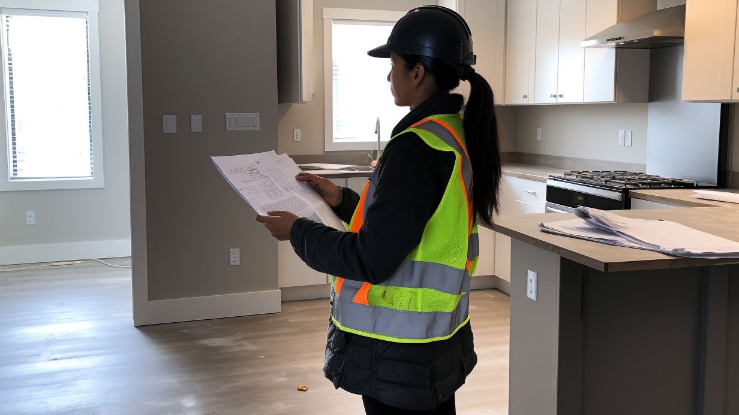
THANK YOU
Questions?

