Slide 1
How often can I carry out a Rent Review in a RPZ?
(https://www.rtb.ie/registration-and-compliance/setting-and-reviewing-rent/rent-reviews-outside-a-rent-pressure-zone)
Frequency – once every 12 months
Rent in a RPZ can only be reviewed once every 12 months. This means that at least 12 months must have passed since the tenancy commencement date or since the date of service of the last valid Notice of Rent Review.
A rent review occurs when the Notice of Rent Review is served.
It is recommended that landlords give extra days’ notice to avoid any issues that may arise in the calculation of the minimum notice period.
Outside of RPZs, landlords are only permitted to review the rent once every 24 months – in other words, at least 24 months must have passed since the tenancy commencement date or since the date of service of the last valid notice of rent review.
A rent review occurs when the notice of rent review is served.

Slide 2
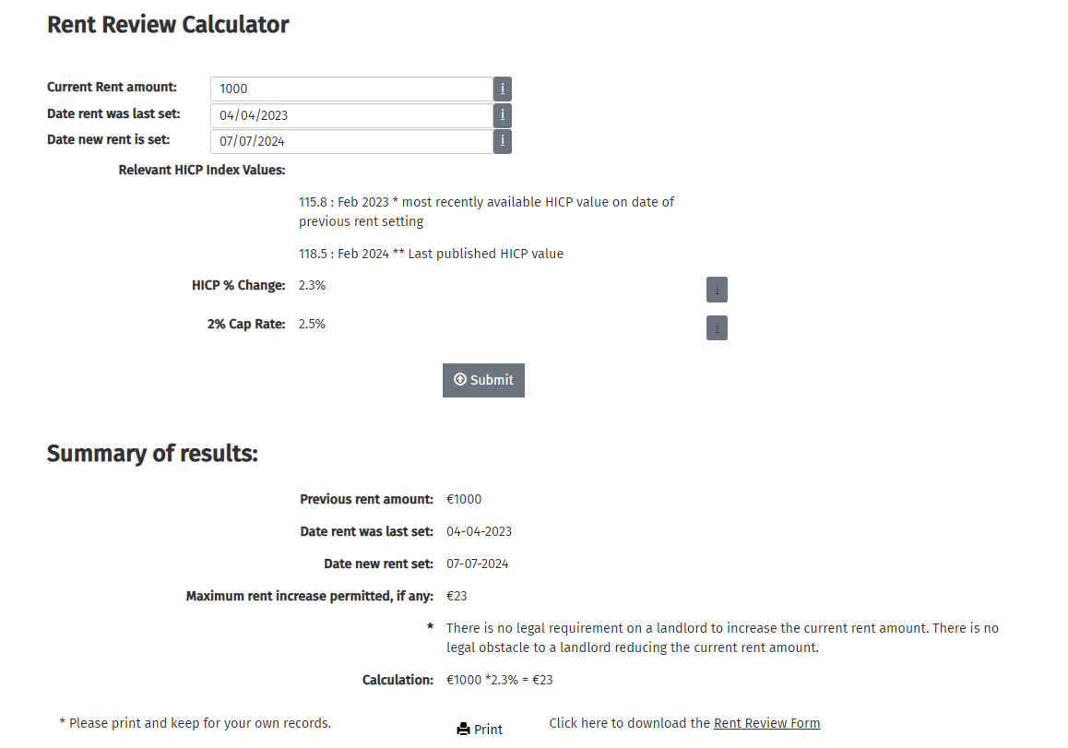
Step 1

Slide 3
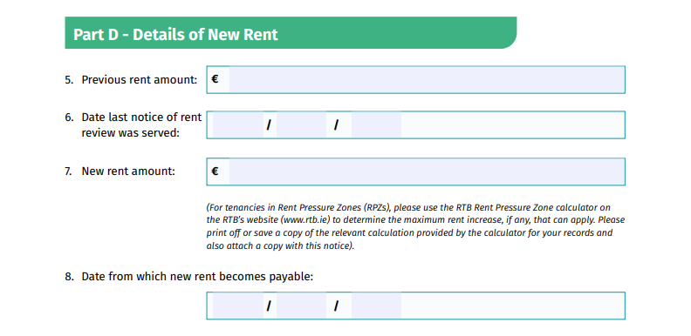
Step 2 & 3

Slide 4
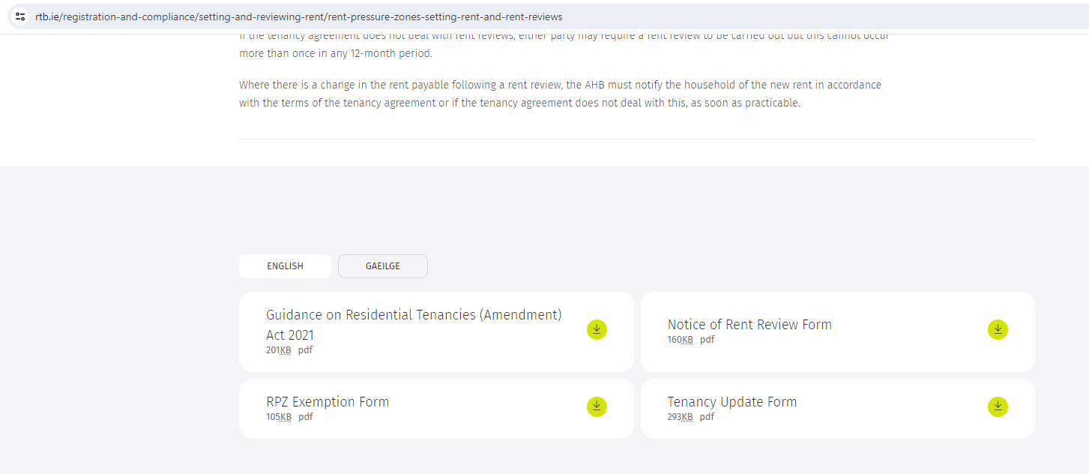
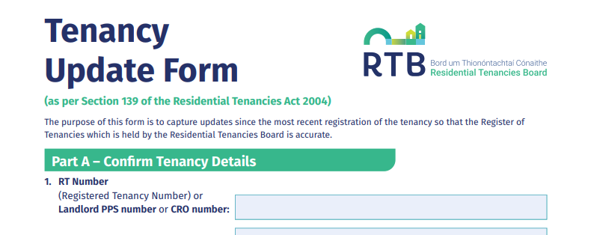
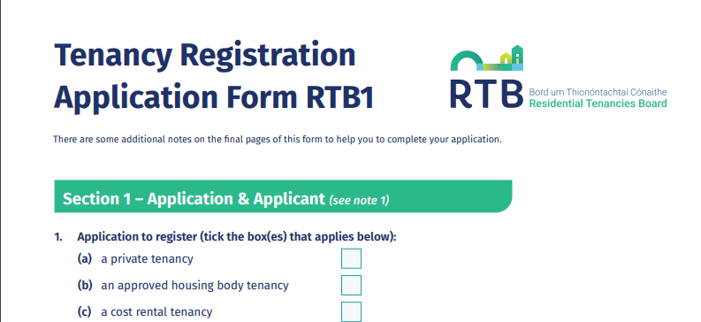
Step 4

Slide 5
Question; How do I avoid 15 month reviews? NB, Not tested! Quote ‘A rent review occurs when the Notice of Rent Review is served.’
Example;
Lease commencement/move in 07.04.22. Rent is set.
Irrespective of anything, your first opportunity to serve a notice is 07.04.23
90 days’ notice is 07.07.2023 when the new rent becomes effective, therefore the ’22/’23 rent is set for 15 months, and the ‘23/’24 rent runs from July ‘23
Quote ‘A rent review occurs when the Notice of Rent Review is served.’
According to this, then your next opportunity to serve notice is 07.04.2024 for the reviewed rent to kick in on 07.07.24;

Slide 6
The Important Steps(14) When Issuing Notices to Tenants
-It becomes clear that the issue (Rent Arrears or Breach of Tenants Obligations) will not be resolved by other means of communication
-The Creation of an appropriately worded cover letter to go with Notice to the tenant
-Doing up the correct Notice (Warning or Termination of Tenancy) in keeping with the strict regulation set out by RTB (website)
-Creating of the Statutory Declaration for Your Client to Sign with Solicitor (if selling)
-Scanning all documents to the file if required for future reference (RTB Dispute)
-All notices should be sent out to the tenants by the An Post, Post & Track system (not registered & Not Personally Delivered ) to be 100% sure the tenants get the notice

Slide 7
The Important Steps (14) When Issuing Notices to Tenants
-Scanning in the An Post, Post & Tracking Receipt for future reference if need be
-Logging on to the An Post website and registering the tracking number so you get an email when it arrives at the property
-Receiving the An Post confirmation email and save to your records
-Fee for Post & Track service within Dublin by An Post is €10
-Send the Notice to the RTB as is required (Rent Arrears Warning Letters/Termination of Tenancy) on the same day
-Chasing the RTB to get confirmation they received a copy of the Notice since they are so slow to send this out
**Checking that the Date on the Letter of Acknowledgement from the RTB is correct
-Scanning in the RTB Letter of Acknowledgement and save to the file for future reference if need be

Slide 8
Some of the most common errors when sending Notices
The address of the property does not match the Eircode
The names of the tenants are spelt wrong (could affect enforcement)
*The Landlord or their Agent forget to send the notice into the RTB on the same day notice is served
Landlords don’t have “proof” of serving (for example if they deliver it themselves)
The RTB send out a letter of Acknowledgement with wrong date on it!
The serving date on the Notice does not match the actual serving date
The notice is not signed
There are errors on the statutory declaration ! (Refer to Next Slide)
The wrong number of days are on the notice or an unreasonable amount of time is given to a tenant to rectify a wrong in a breach of obligation situation (sub-letting/other)

Slide 9
Some of the most common errors on Statutory Declarations
If the Property is Jointly Owned the second owners name is absent from SD
The Solicitors simply does not complete the body of the SD correctly
The Solicitors do not cross out the options clearly enough to make it clear what option they are going for. RTB said it was “ambiguous”
Solicitor forgets to date the SD (date needs to be close to date of ToT Notice)
The landlord or their agent sends a copy of the SD with the ToT Notice and not the original
If the SD is getting signed outside Ireland is countries such as Australia or USA it needs to have an apostille that goes with it. (Refer to Next Slide)

Slide 10
Brief Summary on What is Apostille ? New To RTB Website !
Where a country is not a party to the EC Convention but is a party to the Hague Convention, a statutory declaration can made before any person authorised under the law of that place to administer oaths.
The only form of legalisation that is required is by way of single certificate, called an "apostille", stamped on or attached to the declaration.
An apostille can be obtained from the designated competent authority for the jurisdiction in question. Authorities for the designated competent authority for each jurisdiction.
An apostille only verifies the origin of a document. It does so by certifying the authenticity of the signature on the document, the capacity in which the person signing the document acted and, where appropriate, the identity of the seal or stamp which the document bears. (RTB Website has useful document on this matter)

