Slide 1
Presenter Andrew Cremin
MSCSI MRICS, BSc Prop, CIPS.
Assoc Director, Business Rates & CPO,
CBRE Advisory (Ire).
18th June 2024
Notes:
Morning L & G,
My name is
And I am a RATING VALUER AND ADVISOR WITH CBRE IREL.
THE CPD PRESENTATION TODAY IS AN OVERVIEW OF BUSINESS RATES IN IRELAND.
Take notes of any questions you have, try to get them on the chat board in advance and I can take them at the end of the presentation.

Slide 2
OVERVIEW – BUSINESS RATES VALUATIONS IN IRELAND

Slide 3
AGENDA
Introduction
National Revaluation Programme REVAL 23
Tailte Eireann Merger, New Online Portal for Agents & Mapping Tool
The Valuation Tribunal
New Initiatives and Important Notes
Legislation Update
The Local Government Rates and Other Matters Act 2019
Looking Ahead
Notes:
INTRO
Many of you as agents and property advisors will be asked for advice by your clients, from time to time, about commercial rates and rating valuations.
This presentation will provide you with background, updates and useful nuggets of information regarding Rating in Ireland.
As a responsible advisor and valuer, a working knowledge is always useful to guide your client in the appropriate direction, BUT knowing your expertise limits is equally important when you are drawn into a case. While it is perceived as a niche area of Valuation work, it is very technical and wide ranging. So, for today’s session, I am limiting this to a GENTLE Guide through rating, trying to minimise technical guidance and jargon to a point.
Commercial Rates are a fundamental cost of doing business in every sector in Ireland. It is a significant annual overhead for many businesses, particularly the larger the property, and often represents one of the biggest annual overheads after property rent, yet gets far less attention and mitigation.
Many businesses out there consider rating valuation to be a fait accompli and just file it away. Anecdotally, the statistics from the revaluations programmes to date, bear this out - Response rates are quite low usually. Many confuse the valuation process with the role of the local authority, failing to understand that both are separate and independent of each other.
AGENDA

Slide 4
National Revaluation Programme
Notes:
Since 2008, we have had the National Programme of Revaluation of all commercial property in the state.
These revaluations were critical to establishing a new and more consistent valuation list, replacing the lists dating back to November 1988. To date, almost every local authority area has been revalued with only Cork City and Cork County remaining to be revalued in the next year or so. The map you can see highlights the Revaluation Dates for each County up to Reval23.
As every rating valuer knows, in a Revaluation, the core essence of the “Valuation List” is to establish both “correctness” and “equity and uniformity” for the ratepayer, in accordance with Section 19(5) of the Valuation Acts 2001 to 2020.
The most recent Revaluation, as many of you are aware, took place in 2023, in five counties.
(7 Local Authority Areas).
Donegal, Mayo, Galway County & City, Clare, Kerry and a 2nd Revaluation in Dun Laoighaire-Rathdown.
Final Valuation Certificates were issued to approximately 33,000 ratepayers across these rating authority areas in September 2023, with new rates taking effect on January 1st 2024.
Valuation appeals arising from these Reval Counties have already commenced at the Valuation Tribunal.

Slide 5
TAILTE EIREANN VALUATIONS
Notes:
In the background to the Reval 23 programme and in the run up to it, The Valuation Office merged with the Property Registration Authority and National Mapping and Surveying to become Tailte Eireann. You are looking at a view of the Tailte website homepage.
Familiarity with this website is very important for any valuer advising occupiers.

Slide 6
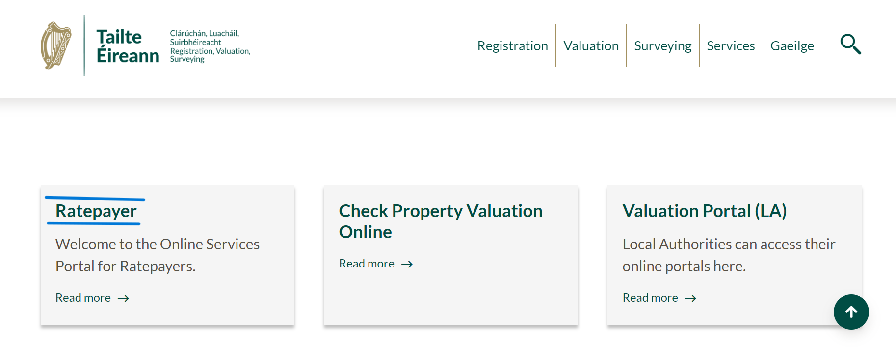
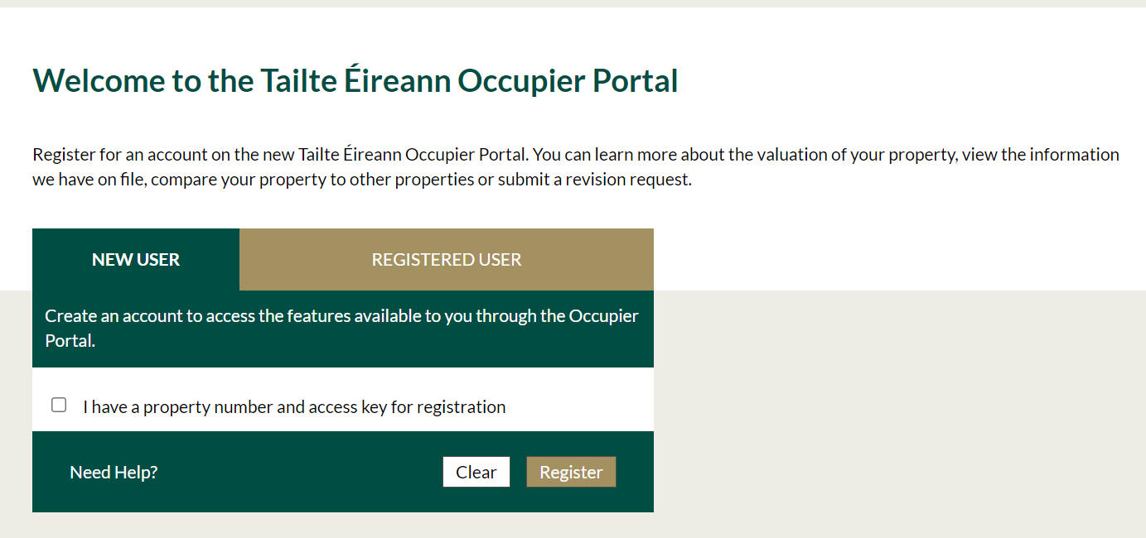
ONLINE PORTALS – Tailte Eireann Valuations
Notes:
In the course of 2022 into 2023, Tailte Eireann Valuation also introduced a new administration system, AXIA, to streamline efficiencies at all levels. The important part of that system for us as advisors, relates to occupiers and/or their agents with a new portal to enable a more efficient exchange of information.
Valuers/Advisor can register as Agents for occupier clients and access property informations, reports, plans recent history, current actions awaiting?

Slide 7
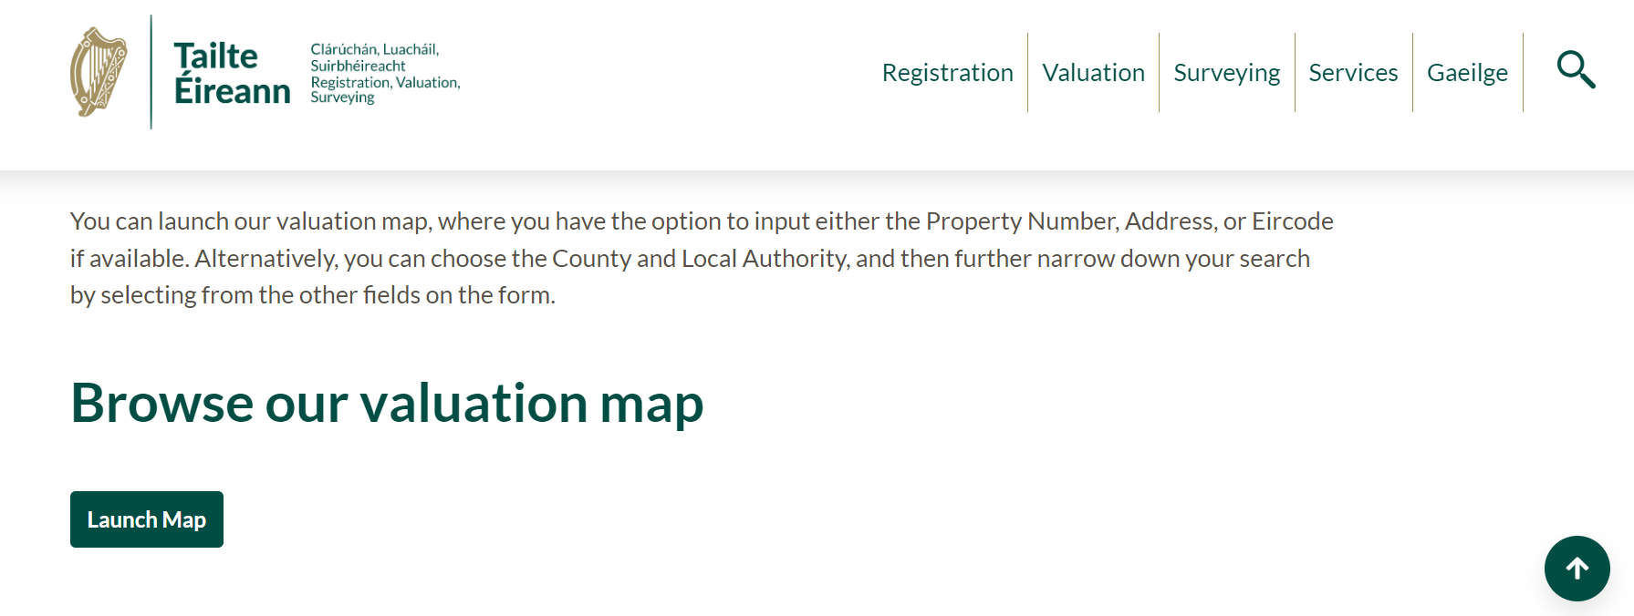
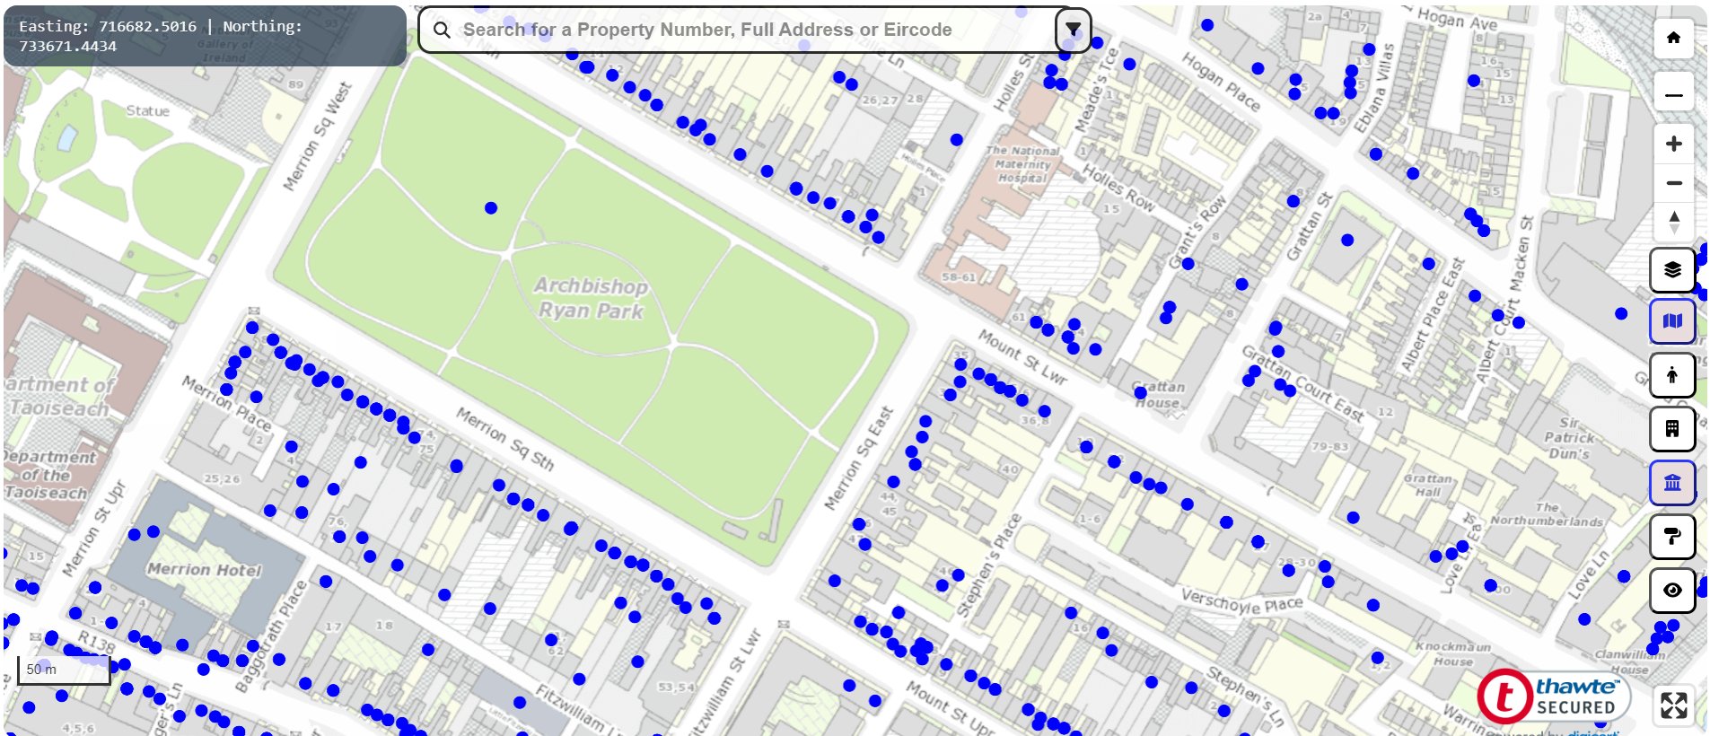
TAILTE EIREANN - Valuation Mapping
Notes:
The TE Valuation mapping is an essential valuation tool, enabling examination of the Valuation List Property Valuation Summaries and also useful comparable information.
Blue dots represent a valuation summary or a selection of valuation within a single property.

Slide 8
THE VALUATION TRIBUNAL
New Initiatives Advance Notification Letters Direction Letters
Important Notes Valuation Tribunal Rules (2019 Precis Evidence Document Submission by Appellant. TE Valuer then has 15 working days to respond with a Precis Evidence document. Document Only or Oral hearing. Expert Witness: Duty, Obligations.
Notes:
With regard to The Valuation Tribunal, a new initiative has been introduced recently to assist with the volume of cases going through the system. The Tribunal now issue what are referred to as “Advance Notification” letters which alert the occupier, their agents and Tailte Eireann of the fact that a particular appeal case is approaching the stage where “Direction Letters” will issue.
This welcome initiative encourages the parties to begin advance engagement, before next stages are reached and they have 15 working days to do so.
If agreement can be reached, then it expedites the process, thus avoiding the need for time consuming extensive precis evidence to be prepared and a subsequent hearing.
Advance Notification Letters: Encourages parties to engage early, sort out matters of fact and even reach a mutual agreement/settlement of the appeal.
IMPORTANT NOTES:
The Valuation Tribunal has a rulebook document, 46 pages. Anyone undertaking a Valuation Tribunal hearing must pay close attention to this document.
Direction Letters: Tells the parties in turn a precis of evidence must be submitted by a stated deadline, either 10 days (Document only) or 15 days (Oral hearings).
Precis Evidence Document Submission by Appellant. Appellant always goes first – ONUS on appellant to prove that the valuation is incorrect or excessive.
TE Valuer then has 10 or 15 days to respond with a precis evidence document. TE Valuer will defend the valuation, citing comparables from the valuation list, including supporting evidence, citing legal authorities in support if applicable.
Document Only or Oral hearing: Selected option on NOA application. This process is looking familiar to many of you engaged in Rent reviews and arbitration hearing, isn’t it? This is a regulated process and run in accordance with court rules. DOC ONLY> Appellant will be given copy of RESPONDANT’S PRECIS & 5 Days to comment. The chair will determine the case or request further information. ORAL HEARING. Both parties will attend at Tribunal offices on Holles Street. Typically, agent or with client sometimes. If appellant has secured legal advsor to be present in form of barrister then, TE will also seek counsel and legal submissions will also be exchanged. As with rent review arbitrations for instance, both expert witnesses will present their precis evidence and cross examine each other on the content, unless counsel is present who exercise that function. IMPORTANT TO NOTE.
As valuer at VT, you are an independent expert witness there for the benefit of the Tribunal only, not your client.
Subject to a right of appeal to the High Court on a point of law, the decision of the Tribunal is final.

Slide 9
LEGISLATION UPDATES
The current legislation governing Rating Valuation is The Valuation Act 2001, as amended.
New Legislation
From a guidance and procedural perspective, we’ve had recent Legislation updates in the form of The Local Government Rates and Other Matters Act 2019.
Annual Rates are liable in full
S11. (1)(a) – The Duty to Notify Rating Authority on transfer of relevant property.
S11. (1)(b) and Discharge Rates.
S11. (2) Consequences of Breach.
S12 – Levy Prescribed Interest.
S13 – Sale of a Relevant Property.
S14 – Unpaid Rates.
S21 – Amendment of Valuation Act 2001:
Notes:
The current legislation governing Rating Valuation is The Valuation Act 2001, as amended.
This act has been amended a number of times since it came into effect and also a variety of statutory instruments were issued over the years.
KNOWLEDGE OF VALUATION ACT 2001 TO 2020
Rating Valuation is a specialised area, so as with all other valuation work, be careful where your experience or technical knowledge is limited IN THIS AREA as you could find yourself out of your depth and struggling.
Important parts of the legislation
Definitions, SCHEDULE 3, RELEVANT Property, SCHEDULE 4, PROPERTY NOT RATEABLE,
VALUATION LIST- SECTION 20. Knowing what it is, how and why it’s formed and function in the valuation process.
TOO MUCH TO COVER IN THIS SESSION.
The most recent legislative update is 2020.
Annual Rates are liable in full on January 1st – no more half year moieties, that you have been used to seeing in your rates bills.
S11. (1)(a) – The duty to notify rating authority on transfer of relevant property. Where relevant property is transferred from one person to another, it is the owner’s duty notify within 2 weeks of the date of transfer.
S11. (1)(b) and Discharge rates due up to the date of transfer.
S11. (2) Consequences of breach – The owner shall be liable for equivalent of no more than 2 years rates, due from previous occupier, if requirements of S11.(1). (a) & (b) have not been met.
S12 – The rating Authority are permitted to levy prescribed Interest on unpaid rates which takes effect from 2025.
S13 – On the Sale of a Relevant Property – pay rates due before completion of the sale.
S14 – Unpaid Rates remain a charge on the property.
S21 – Amendment of Valuation Act 2001: “An amendment of a Valuation List shall have full force, from the date of its making….for the purposes of the rating authority concerned making a rate in relation to the property”. This has a particular ramification for “Extensions” etc.

Slide 10
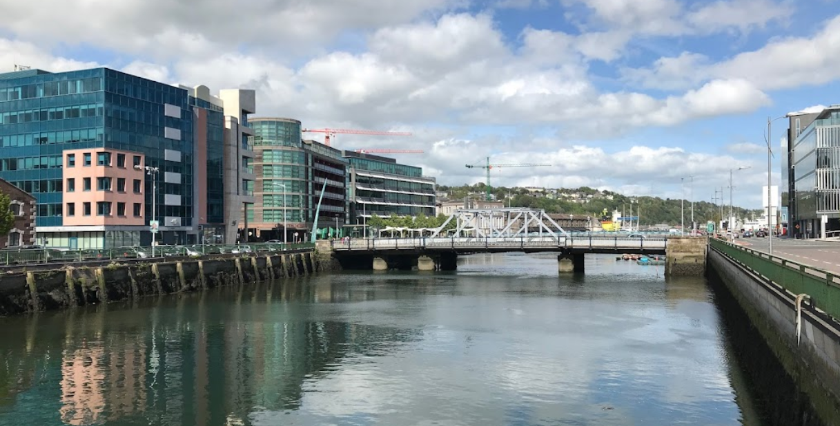
LOOKING AHEAD
THE CORK REVALUATION
DUBLIN CITY REVALUATION
NATIONAL REVISION PROGRAMME
Notes:
Coming along next, The Cork Revaluation is expected but has already been postponed a number of times by TE for various operational reasons. This REVAL will INCLUDE CORK CITY COUNCIL AREA AND CORK COUNTY COUNCIL AREAS.
Covid was the primary factor for much of the rescheduling.
In addition, the Revaluation of Dublin City Council local authority area is also expected.
National Revision Programme
In the meantime, the National Revision programme will have picked up pace now that resources in TE are freed up after Reval23.
Many of you around the country no doubt will be hearing from local business firms, looking for advice and guidance with regard to “Proposed or Final” Valuation Certificates that they’ve received.
Revision is quite different to the Revaluation process. Revision comprises additions of new property to an existing valuation list OR “Revising” the existing valuation of a property due to a physical change (s) to that property. Particular attention must be paid to the actual Valuation Date, especially where that Valuation List may have been established some years before, where property rent value is being disputed.

Slide 11
LOOKING AHEAD
The World of Rating Valuation
Notes:
Looking ahead, the world of rating valuation is fast becoming more specialised with the intricacies of building use, building sustainability and alternative energy efficiencies for the rating valuer and TE’s valuers.
The level of knowledge and experience required in rating valuation is quite in depth and complex, ranging from property and business knowledge to detailed familiarity with relevant legislation and established legal authorities from the Valuation Tribunal.
Within these sectors, at any given time, as these properties and technologies evolve, there are rating cases on appeal where the rateability of some property types and legislative interpretation, is regularly tested, all the way to the High Court.
The Energy sector comprises many providers and has evolved with presence of WIND FARMS, SOLAR FARMS, OFFSHORE ENERGY GENERATION – WIND for now, then we have BATTERY STORAGE, DATA CENTRES – EVER TOPICAL WITH CONSUMPTION CHALLENGES, with ancillary infrastructures.
Pharmaceutical operations around the country where many have more and more complex manufacturing systems and buildings.
Agriculture and Food production has become far more sophisticated and complex from the Farm to Dairy Manufacturing and Meat Production Plants.

Slide 12
CONCLUSION
ANY QUESTIONS?
THANK YOU.
Andrew Cremin MSCSI MRICS, BSc Prop, CIPS.
Assoc Director, Rating & CPO Department,
CBRE Advisory (Ire).
TEL: 087 6787202
andrew.cremin@cbre.com
Notes:
In conclusion, for the rating valuer, the depth of knowledge required has no bounds where rating valuation is increasingly complex and diverse, but yet it’s one of the most interesting and challenging environments in which to practice one’s profession.
Not just technically challenging but a first hand experience of the EXCITING, DIVERSE Businesses sector across this country.

Slide 13
Dating back to 1895, the Society of Chartered Surveyors Ireland is the independent professional body for Chartered Surveyors working and practicing in Ireland. Working in partnership with RICS, the pre-eminent Chartered professional body for the construction, land and property sectors around the world, the Society and RICS act in the public interest: setting and maintaining the highest standards of competence and integrity among the profession; and providing impartial, authoritative advice on key issues for business, society and governments worldwide. Advancing standards in construction, land and property, the Chartered Surveyor professional qualification is the world’s leading qualification when it comes to professional standards. In a world where more and more people, governments, banks and commercial organisations demand greater certainty of professional standards and ethics, attaining the Chartered Surveyor qualification is the recognised mark of property professionalism. Members of the profession are typically employed in the construction, land and property markets through private practice, in central and local government, in state agencies, in academic institutions, in business organisations and in non-governmental organisations. Members’ services are diverse and can include offering strategic advice on the economics, valuation, law, technology, finance and management in all aspects of the construction, land and property industry. All aspects of the profession, from education through to qualification and the continuing maintenance of the highest professional standards are regulated and overseen through the partnership of the Society of Chartered Surveyors Ireland and RICS, in the public interest. This valuable partnership with RICS enables access to a worldwide network of research, experience and advice.
www.scsi.ie
Society of Chartered Surveyors Ireland 38 Merrion Square, Dublin 2, Ireland Tel: + 353 (0)1 644 5500 Email: info@scsi.ie

